Slide 1
Alison Laver-Fawcett PhD, OT(C), DipCOT, PCAP,
December 2016 a.laverfawcett@yorksj.ac.uk
Activity Card Sort -United Kingdom
Notes:
Thank you for the opportunity to share with you today our research to evaluate the clinical utility and face validity of the United Kingdom version of the Activity Card Sort which I will refer to as the ACS-UK.
Eight occupational therapy students were collaborative researchers in a dissertation project which contributed to the development of the Activity Card Sort – United Kingdom
ENOTHE meeting
Friday 23rd October 2015
Oral Presentations are a maximum of 30 minutes (5 minutes to prepare, 20 minutes presentation and 5 minutes for questions and answers).

Slide 2
A standardised assessment is
‘A published measurement tool, designed for a specific purpose in a given population, with detailed instructions provided as to when and how it is to be administered and scored, interpretation of the scores, and results of investigations of reliability and validity’
(Cole et al, 1995, p. 22)

Slide 3
How can you tell if an assessment is standardised?
Is there a test manual?
Does the test manual describe:
  the test development process?
  the purpose of the test
  client group for whom the test has been developed?
  details of psychometric studies undertaken to establish reliability and validity?
  the materials needed for test administration or are these included as part of the test package?
  the environment that should be used for testing?

Slide 4
How can you tell if an assessment is standardised?
Is there a protocol for test administration that provides all the instructions required to administer the test?
Is there guidance on how to score each test item?
Is there a scoring form for recording scores?
Is there guidance for interpreting scores?

Slide 5
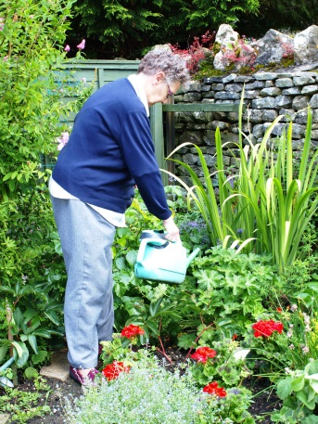
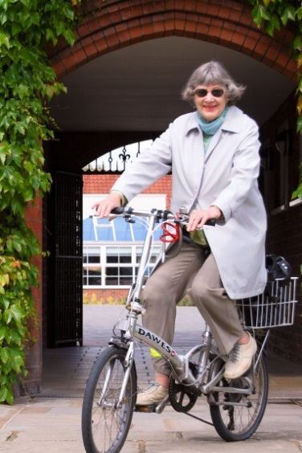
Activity Card Sort -United Kingdom
A Q-sort assessment
Underpinning evidence base
Notes:
Thank you for the opportunity to share with you today our research to evaluate the clinical utility and face validity of the United Kingdom version of the Activity Card Sort which I will refer to as the ACS-UK.
Eight occupational therapy students were collaborative researchers in a dissertation project which contributed to the development of the Activity Card Sort – United Kingdom
ENOTHE meeting
Friday 23rd October 2015
Oral Presentations are a maximum of 30 minutes (5 minutes to prepare, 20 minutes presentation and 5 minutes for questions and answers).

Slide 6
Key reference
Laver-Fawcett AJ, Mallinson S (2013)
The Development of the Activity Card Sort – United Kingdom version (ACS-UK).
OTJR: Occupation, Participation, and Health, 33 (3), 134-145.
DOI: 10.3928/15394492-20130614-02

Slide 7
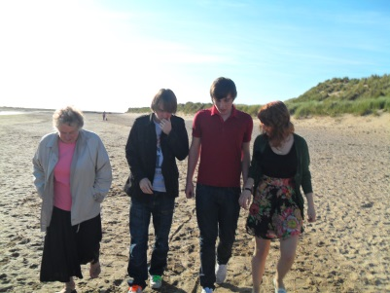

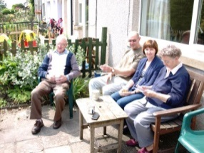
Introduction
The World Health Organisation (WHO, 2012): ‘everyone benefits from communities, workplaces and societies that encourage active and visible participation of older people’ (p.10)
Participation: ‘engagement in work, play, or activities of daily living that are part of one’s socio-cultural context and that are desired and / or necessary to one’s well-being.’ (Kielhofner, 2002, p. 115)
Participation in required activities, alongside engagement in active recreational interests, is associated with:
  lower levels of depression,
  better cognition
  higher health-related quality of life in older people
                (Kalldalen, Marcusson & Wressle, 2013)
Notes:
The World Health Organisation (WHO, 2012) has encouraged societies to develop ‘new models of ageing for the 21st century’ because the proportion of older people in the global population is projected to increase presenting significant social and economic challenges;
WHO asserts that ‘everyone benefits from communities, workplaces and societies that encourage active and visible participation of older people’ (p.10).
Participation has been defined as ‘engagement in work, play, or activities of daily living that are part of one’s socio-cultural context and that are desired and / or necessary to one’s well-being’ (Kielhofner, 2002, p. 115); this definition acknowledges the importance of social factors and culture on people’s expectations of activity participation.
Extant research attests to this as it indicates that participation in required activities, alongside engagement in active recreational interests, is associated with lower levels of depression, better cognition and higher health-related quality of life in older people (Kalldalen, Marcusson & Wressle, 2013).

Slide 8
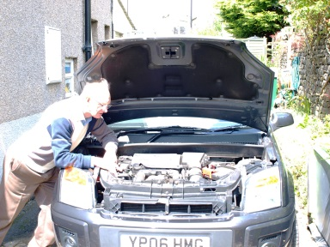
Occupational therapy and participation
Occupational therapists can make important contributions to both prevention and remediation services for older people through enabling participation in meaningful occupations (Clark et al., 2011)
Further research is required to increase understanding of the factors that facilitate participation and evaluate occupational therapy interventions that are directed at increasing participation (Law, 2013)
This is a particular issue for: older populations with stroke (Spitzer, Tse, Baum & Carey, 2011) and mental health problems (Bannigan & Laver-Fawcett, 2011)
Reliable and valid measures of older people’s activity participation are essential for such research
The Activity Card Sort (ACS; Baum & Edwards, 2008) is recognised internationally as a useful self-report measure of participation for clinical practice and research (e.g., Eriksson, et al., 2011)

Slide 9

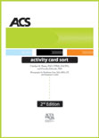
Activity Card Sort (ACS)
Well established measure of activity engagement for older people
    (2nd edition, Baum and Edwards, 2008)
Originally developed by Dr Carolyn Baum for use with people with dementia in the USA in early 1990s (Baum, 1993)
Photograph cards for activities grouped in 4 categories:
  Instrumental
  Low Demand leisure
  High Demand Leisure
  Social
3 ACS versions: Recovery, Institutional and Community Living
Each version uses the same 89 activity cards
Different sorting categories of engagement and scoring methods

Slide 10
Descriptive Assessments
Provide information which describes the current functional status of the client
Focuses on the identification of the clients functional abilities and limitations
Functional status data is important for clinical decision making and for setting functionally oriented treatment goals
Need to be detailed and sensitive to determine factors which are limiting the client’s ability
(Laver-Fawcett, 2012)

Slide 11
Evaluative Assessments
are used to detect change in the client’s occupational performance and / or performance component functioning over time
can be used to monitor the client’s progress during rehabilitation and determine the effectiveness of a specific treatment intervention
need to be sensitive and have established test-retest reliability
(Laver-Fawcett, 2012)

Slide 12
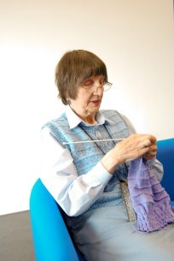
Uses of the ACS
The Activity Card Sort (ACS) measures an individual's occupational performance (descriptive assessment)
Used to monitor changes in activity participation over time due to a chronic health condition, a stroke or aging (evaluative assessment)
Comparing premorbid engagement in activities with current activity participation (Baum, Perlmutter & Edwards, 2000; Hartman-Maeir, Soroker, Ring, Avni & Katz, 2007)
Useful for initial assessment, goal setting and intervention planning (descriptive assessment)
To monitor changes in activity participation following onset of illness (Albert, Bear-Lehman & Burkhardt, 2009; Chan, Chung & Packer, 2006; Packer, Boshoff & DeJonge, 2008) (evaluative assessment)
To evaluate the effects of an intervention designed to impact on a person’s activity participation (evaluative assessment)
Creating an occupational history (descriptive assessment)
(Canadian Stroke Network – Stroke Engine Assess, n.d.)

Slide 13
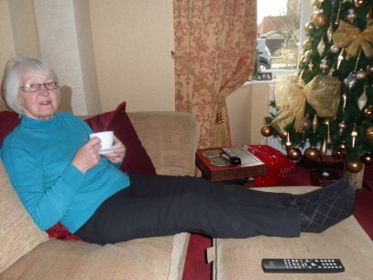
The ACS as a research measure
The ACS has been used to research participation for:
Older people living in the community (Everard et al., 2000)
Older people facing disability transitions (Albert, Bear-Lehman & Burkhardt, 2009)
People experiencing cognitive deficits (Baum, 1995)
People with stroke (Edwards, Hahn, Dromerick, & Baum, 2005)
People with vision problems (Packer, Girdler, Boldy, Dhaliwal, & Crowley, 2009)

Slide 14
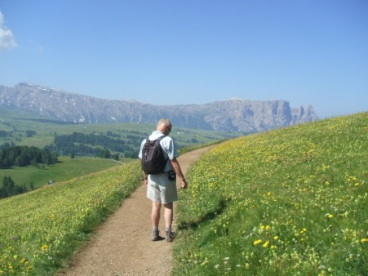
Relevance to culture and environment
Cross-cultural research has demonstrated that the ACS has improved validity and utility when the activities depicted are relevant to people’s culture and environment
(Chan, Chung & Packer, 2006; Doney & Packer, 2008; Eriksson et al., 2011; Katz, Karpin, Lak, Furman, & Hartman-Maeir, 2003)

Slide 15
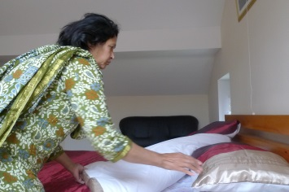
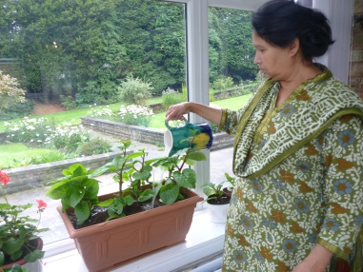
Cultural sensitivity issues
2009 & 2010 Dissertation projects when students used the ACS as a measure with people with dementia and carers identified cultural sensitivity issues
(Laver-Fawcett, 2012)
Kessler and Egan (2012) undertook a review of measures to evaluate participation outcomes post-stroke and identified the ACS as a potentially useful measure. However, they noted limitations for use in the UK as the ACS depicts some activities that appear culturally specific to the US
Notes:
(Laver-Fawcett, 2012), involved the administration of the ACS to explore the participation of older people with dementia and their care-givers.
Findings indicated that the ACS was an effective measure of participation with these groups, however, a number of the ACS photographs depicting activities and some activity labels proved problematic for cultural reasons (Laver-Fawcett, 2012).
A major concern related to semantics as American English is used for the wording of ACS activity descriptions and several terms used appear uncommon in the UK.
For example: ‘Taking out the trash’ (the usual UK term is ‘putting out the rubbish’); ‘Yard maintenance’ (instead of ‘gardening’); and ‘Getting gas’ (rather than ‘going to get petrol / diesel’).
The content of some ACS photographs depict activities less usual in the UK, such as baseball (football, cricket or rugby are more common sports).
Some background environments were clearly American and cars showed the driver on the left-hand side whereas in the UK cars are right-hand drive (Laver-Fawcett, 2012).

Slide 16

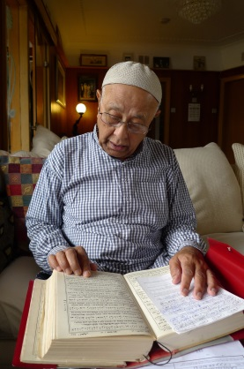
Cultural sensitivity issues
The development of culturally sensitive ACS versions is now enabling cross-cultural research
For example, complied ACS data from well elderly samples (total N = 468) has enabled a cross-cultural comparison of older people’s participation (Eriksson et al., 2011)
Notes:
(Laver-Fawcett, 2012), involved the administration of the ACS to explore the participation of older people with dementia and their care-givers.
Findings indicated that the ACS was an effective measure of participation with these groups, however, a number of the ACS photographs depicting activities and some activity labels proved problematic for cultural reasons (Laver-Fawcett, 2012).
A major concern related to semantics as American English is used for the wording of ACS activity descriptions and several terms used appear uncommon in the UK.
For example: ‘Taking out the trash’ (the usual UK term is ‘putting out the rubbish’); ‘Yard maintenance’ (instead of ‘gardening’); and ‘Getting gas’ (rather than ‘going to get petrol / diesel’).
The content of some ACS photographs depict activities less usual in the UK, such as baseball (football, cricket or rugby are more common sports).
Some background environments were clearly American and cars showed the driver on the left-hand side whereas in the UK cars are right-hand drive (Laver-Fawcett, 2012).

Slide 17


Other versions of the ACS
Researchers have adapted the ACS to develop eight culturally sensitive and valid versions for use in:
Arab countries (A-ACS; Hamed et al., 2011; Hamed & Holm, 2013)
Australia (ACS-Australia; Packer, et al., 2008)
Hong-Kong (ACS-HK; Chan et al., 2006)
Israel (Katz et al., 2003; Sachs & Josman, 2003)
Korea (Lee, 2009, as cited in Eriksson et al., 2011)
Puerto Rico (Orellano, 2008)
Netherlands (Jong, van Nes, Lindeboom, 2012)
Singapore (as reported by Eriksson et al, 2011)

Slide 18
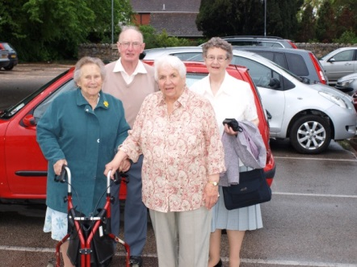
ACS review
A useful overview of the ACS is available at:
Canadian Stroke Network – Stroke Engine Assess (n.d.) In Depth Review of the Activity Card Sort (ACS). [Internet] Available from:
http://strokengine.ca/assess/module_acs_indepth-en.html [accessed 26 February 2016]

Slide 19
Background:
Activity Card Sort (ACS)
The Activity Card Sort (ACS; Baum & Edwards, 2008) is recognised internationally as a useful self-report measure of participation for clinical practice and research (e.g., Eriksson, et al., 2011)
ACS-UK (Laver-Fawcett & Mallinson, 2013) has 93 Photograph cards for activities grouped in 4 categories:
  Instrumental, Low Demand Leisure, High Demand Leisure, Social/Cultural
3 ACS-UK versions: Recovery, Institutional and Community Living (using the same 93 photo activity cards)
Different sorting categories of participation levels used for each of the three versions
Notes:
I thought it would be useful to provide a brief summary for those of you unfamiliar with the ACS. The Activity Card Sort is a well established measure of activity engagement for older people. It is recognised internationally as a useful self-report measure of participation for both clinical practice and research (e.g., Eriksson, et al., 2011)
It was originally developed by Dr Carolyn Baum, from Washington University School of Medicine in St Louis, USA for use with people with dementia (Baum, 1993). A 2nd edition was published in 2008 by Baum and Edwards .
This comprises 89 Photograph cards for activities grouped in 4 categories:
Instrumental, Low Demand Leisure, High Demand Leisure and Social Activities
There are 3 ACS versions:
A Recovery version (e.g. with people with Stroke)
An Institutional version (e.g. people with dementia moving into a long-term care setting)
And a Community Living (e.g. for older people experiencing transitions such as retirement or a care-giver role)
Regardless of the version used the same 89 photo activity cards are sorted however there are different sorting categories of engagement for the three versions
A score to reflect the percentage of activity retained in older age / following illness is calculated.

Slide 20
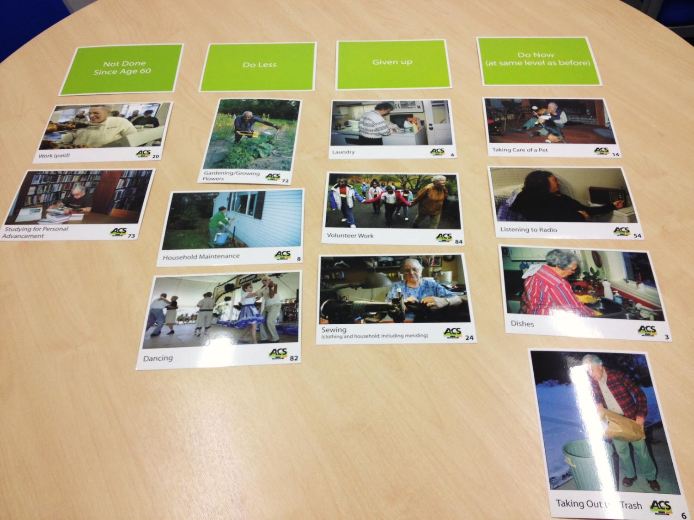
The ACS uses Q-Sort Methodology
(Stephenson, 1936)
Notes:
The ACS employs a Q-Sort methodology.
This slide shows some sorting category cards in green and a few of the ACS cards which have photographs of older people engaging in activities in addition to written activity labels.
According to Law, Baum and Dunn (2001) sorting photographs is desirable because;
it enables individuals with lower literacy levels to conduct the sort
prompts recall of activity engagement to help build a client’s occupational profile

Slide 21
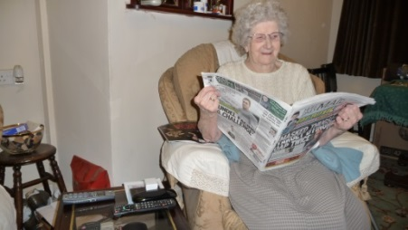
Q-Sort methodology
The Q-Sort methodology was originally described by Stephenson (1936 as cited in Block, 1961, p. 12) for collecting subjective data and involved the sorting of statements which were printed separately on cards to allow for ordering by subjects depending on their individual perspective.
Sorting photographs is desirable because it enables individuals with lower literacy levels to conduct the sort and prompts recall of activity engagement to help build a client’s occupational profile
(Baum and Edwards, 2001; Law, Baum, Dunn, 2001)

Slide 22
Sorting categories for ACS versions
Recovery version (Form B)
Not Done
Before
Current
Illness or
Injury
Continued to
Do During
Illness or
Injury
Doing Less
Since Illness or
Injury
Given Up Due
to Illness or
Injury
New Activity
Since Illness
or Injury
Community-Living version (Form C)
Not done since age 60
Do Now
Do Less
Given Up
Done
Previously
Institutional version (Form A)
Done prior to illness / injury or admission
Not done prior to illness / injury or admission
Not done in past year
+ Identify the five most important activities to you (they may be those you no longer do)
Notes:
In all three ACS forms, individuals are asked to identify the five activities they consider most important as a guide for intervention (Baum and Edwards, 2001).
The occupational therapist can then calculate a current activity score by totalling the items recoded as do now and do less.
A score to reflect the percentage of activity retained in older age / following illness can further be calculated by dividing the current activity total by a total accounting for previous activity.
The version from the Netherlands found not done since age 60 problematic and their version anchors the sort against – not done in the past year

Slide 23
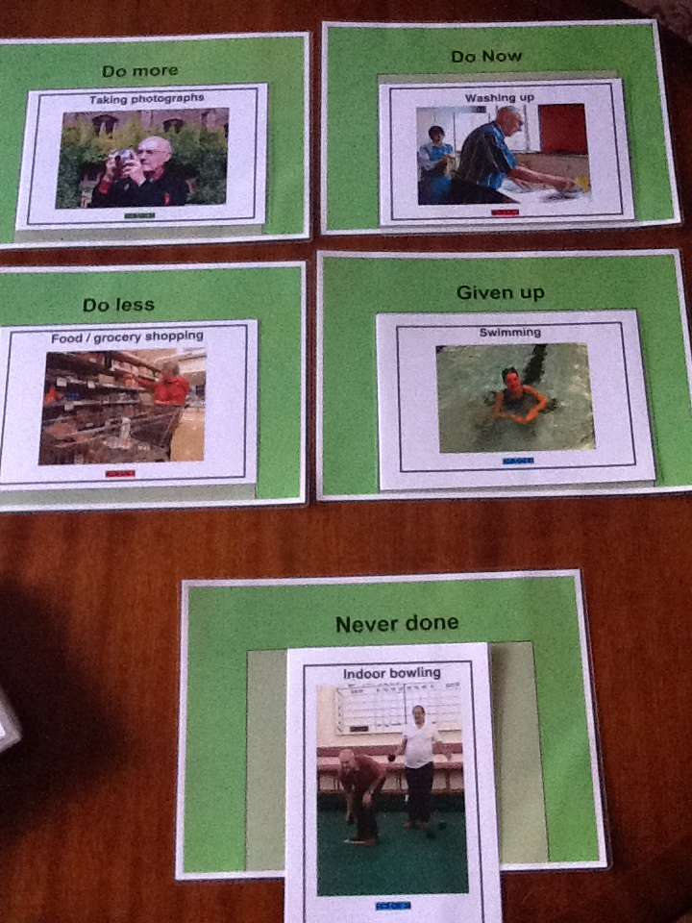
A4 Sorting category cards are placed on the table in from of the client.
ACS-UK has 93 activity cards
Each has a photograph and activity label
The person is given 4 piles of activities to sort:
Instrumental Activities of Daily Living (IADL)
Low Demand Leisure (LDL)
High Demand Leisure (HDL)
Social Cultural (SC)

Slide 24
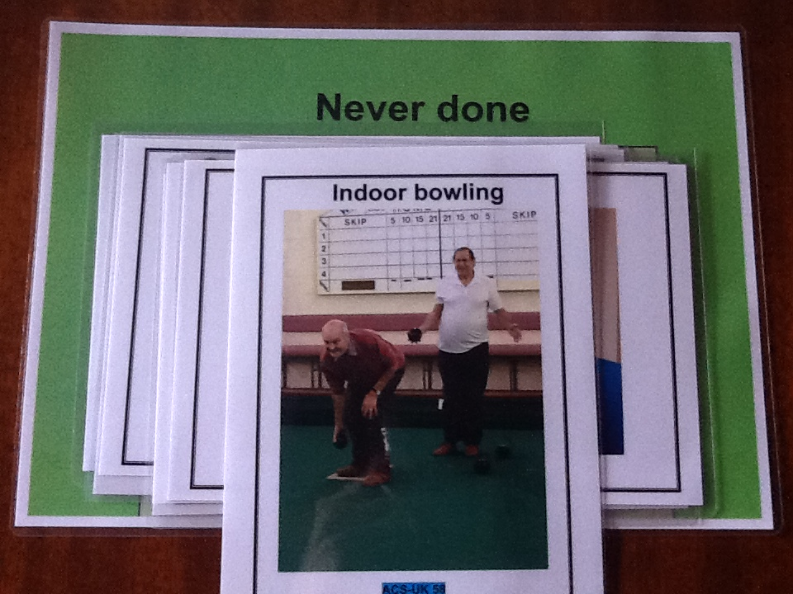

Slide 25
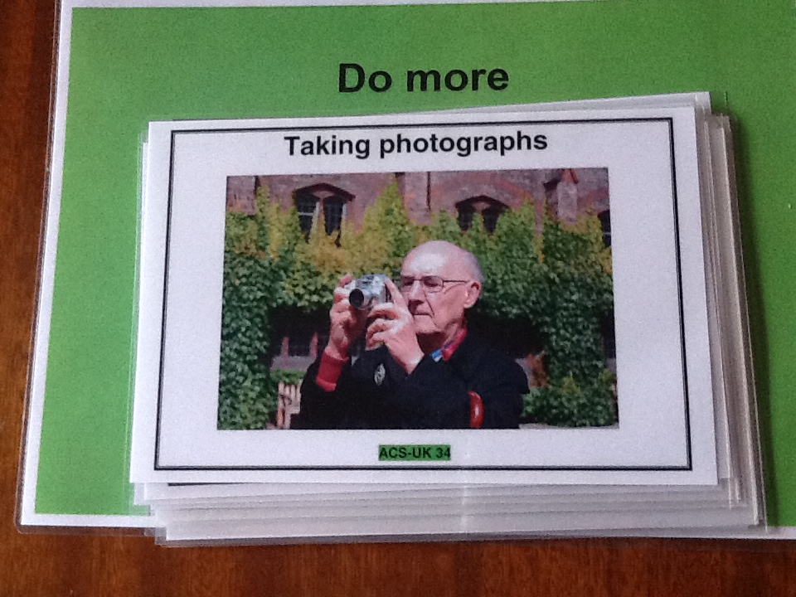

Slide 26
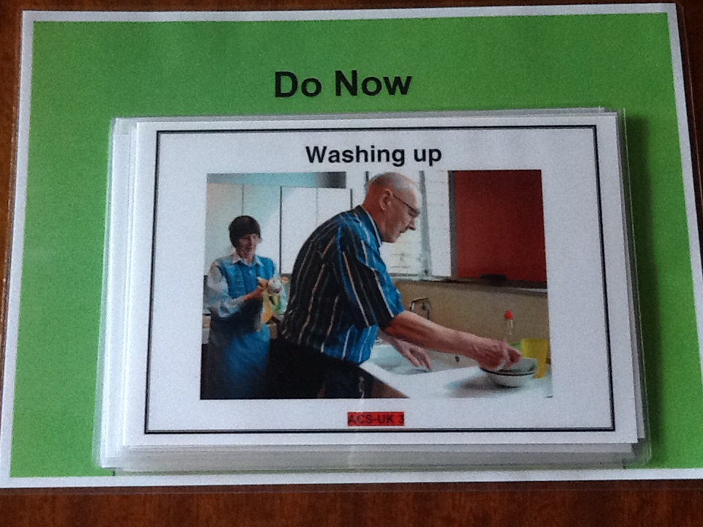

Slide 27
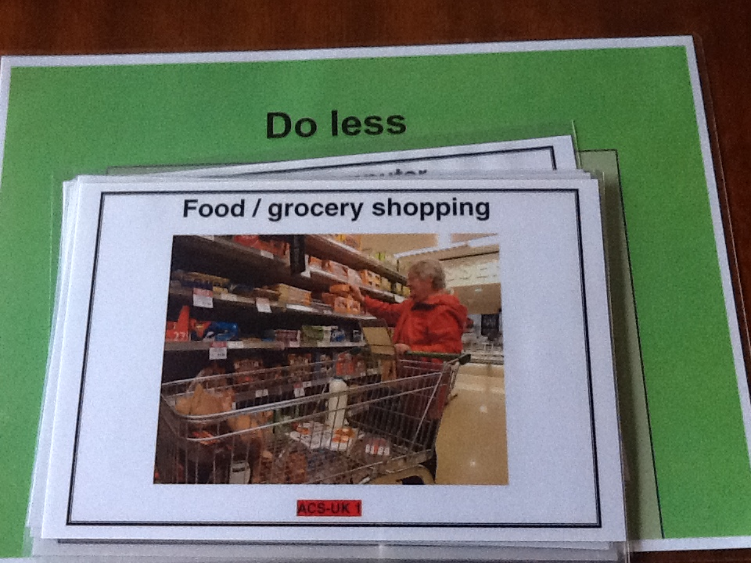

Slide 28
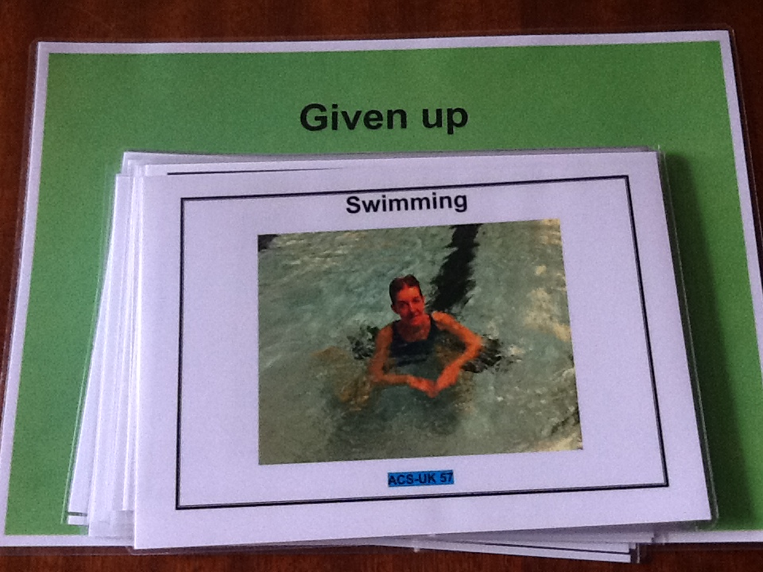

Slide 29
Scoring for ACS-UK
Community-Living version (Form C)
Never Done
Not done in past year
(optional)
Do More
(score as do now)
Do Now
(1)
Do Less
(0.5)
Given Up
(0)
Done
Previously
Calculated after sort:
Do More + Do Now + Do Less + Given Up
+ At the end participants are asked to “identify the five most important activities to you (they may be those you no longer do)”
Notes:
In all three ACS forms, individuals are asked to identify the five activities they consider most important as a guide for intervention (Baum and Edwards, 2001).
The occupational therapist can then calculate a current activity score by totalling the items recoded as do now and do less.
A score to reflect the percentage of activity retained in older age / following illness can further be calculated by dividing the current activity total by a total accounting for previous activity.
The version from the Netherlands found not done since age 60 problematic and their version anchors the sort against – not done in the past year

Slide 30
Example – part of ACS-UK scoring form (HDL domain)
ACS-UK card | ACS-UK Activity | Never Done | Not done in past year | Do More | Do Now | Do Less | Given Up | Done Previously | Scores | Comments
 | High Demand Leisure |  | Not sorted
53 | Going to the Beach |  |  |  |  | 0.5 |  | 1
54 | Recreational Shopping |  |  |  |  | 0.5 |  | 1
55 | Dancing |  |  |  |  |  | 0 | 1 |  | Used to go to tea dances with her husband
56 | Swimming |  |  |  |  |  | 0 | 1
57 | Indoor Bowling | X
58 | Outdoor Bowling | X
59 | Playing Golf | X
60 | Walking |  |  |  |  | 0.5 |  | 1
61 | Hiking / Rambling | X
62 | Exercising |  |  |  |  | 0.5 |  | 1
63 | Riding a Bicycle |  |  |  |  |  | 0 | 1
64 | Going on Holiday / Travelling |  |  |  |  | 0.5 |  | 1
65 | Attending a Hobby / Leisure Group |  |  | X | 1 |  |  | 1 |  | Joined a local tai chi club
66 | Going to Gardens / Parks |  |  |  |  | 0.5 |  | 1 |  | Would like to go more
67 | Fishing | X |  |  |  |  |  |  |  | But use to go with father as a child and watch him fishing
 | Total High Demand Leisure Activities | 5 |  | 1 | 1 | 3 | 3x 0= 0 | 10 | Current | 1 + 3 = 4 (CA)
 |  |  |  |  |  |  |  |  | Previous | 10 (PA)
 |  |  |  |  |  |  |  |  | % Retained | 4/10 = 0.4 x100 = 40% (RAS)

Slide 31

What is Validity?
Does it DO what it says on the tin
Validity: is the ‘extent to which a measurement method measures what it is intended to’
(McDowell and Newell, 1987, p. 330)
Validity relates to the appropriateness and justifiability of the things supposed about the person’s scores on a test and the rationale therapists have for making inferences from such scores to wider areas of functioning
(Bartram, 1990)

Slide 32
Why is validity important?
The things OTs measure are not always directly observable
Test items are developed to elicit self-reported descriptions (e.g. of feelings)
People are provided with test items that link to hypothesised behaviours

Slide 33
Validity
Three types of validation studies, known as:
content validation
construct validation
criterion related validation
are traditionally performed during test development
(Crocker and Algina, 1986)

Slide 34
Content validity
The degree to which an assessment measures what it is supposed to measure judged on the appropriateness of its content as judged by ‘the comprehensiveness of an assessment and its inclusion of items that fully represent the attribute being measured’
(Law, 1997, p. 431)
content analysis of literature
and / or
expert panel review
Have the domains to be measured been weighted to reflect their relative importance to the overall content area?

Slide 35
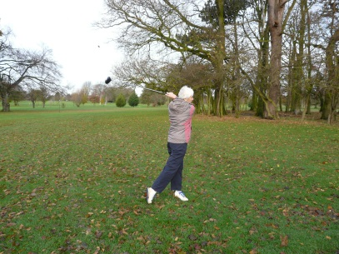
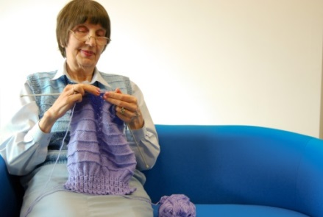
ACS-UK study: Purpose
To conduct a content validity study to generate and select culturally relevant activity items for inclusion in the ACS-UK.
The challenge for test developers is ‘striking a balance between the emic perspective (seeking equivalence within the culture) and the etic perspective (maintaining comparability)’
(Alegria et al., 2004)
The methods used to develop other ACS culturally relevant versions were reviewed to inform this study’s methodology.
We aimed to produce a measure that included activities culturally relevant to UK older people and that replicated the ACS’ Q-sort, sorting categories and scoring method.
This study was undertaken with permission and advice on the methodology from the authors of the ACS (Baum & Edwards, 2008).

Slide 36
Ethics
Ethical approval for all ACS-UK studies have been obtained from the York St John Ethics Committee or the YSJU Health Subjects Ethics Committee
Acknowledgments:
Professor Carolyn Baum for permission to develop a UK version of the Activity Card Sort.
Faculty of Health and Life Sciences for funding for research assistant, Sarah Mallinson 1 day per week for one academic year,

Slide 37
ACS-UK: Mixed Method
Item generation
Item selection and reduction
Activities were drawn from the most empirically robust published versions of the ACS (in English)
  (Australia, Packer et al., 2008; Hong-Kong, Chan et al., 2006; Israel, Katz et al., 2003; and US, Baum & Edwards, 2001; 2008)
Literature search of peer-reviewed research published in the last decade identified three UK time-use studies involving samples of UK older people
  (Ball, Corr, Knight, & Lowis, 2007; Chilvers, Corr, & Singlehurst, 2010; Knight et al., 2007)
Expert Opinion
Consulting a sample of people aged 65 years and over to determine the most common activities for this age group in the UK.
A survey-based design
Two-round mixed-method approach.
Round 1 comprised an activity participation questionnaire (postal or on-line survey): n = 177
Round 2 involved a further activity participation questionnaire completed either individually (postal or via interview) or in small focus groups: n = 21

Slide 38
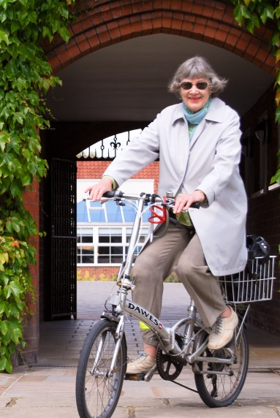
Participants
Inclusion criteria for both Rounds 1 and 2 were:
  people aged 65 years or older
  Living in the community
  Able to communicate in English
  Activity levels not restricted by illness or disability
Individuals were excluded if they were receiving care from social or national health services (other than routine general practitioner care, e.g., annual flu vaccination).
Participant recruitment was sought from all four countries and intended to reflect UK census data regarding ethnicity (Office for National Statistics, 2001)
Sampling:
  convenience sampling through personal and professional contacts
  purposive sampling using website-advertised older people groups
  snowball sampling
Combined total of N = 196 older people contributed to the development of the ACS-UK

Slide 39

ACS-UK: 1st Round survey
125 activity items to assess level of activity participation over the past year rated on a 5-point ordinal scale:
    1 = at least once a day
    2 = at least once a week
    3 = at least once a month
    4 = at least once a year
    5 = never
Participants were asked to suggest and rate their participation in up to five additional activities
Demographic questions
Option of postal survey or on-line version

Slide 40
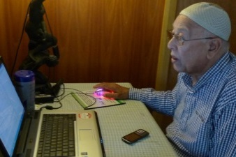
ACS-UK study: Round 2
to consider the additional activities provided by respondents in Round 1 and establish if these new activities would be relevant to the wider UK older population
Perceived participation was rated on a 5-point ordinal scale: (0 = no-one does this activity to 4 = most people do this activity)
to review activity items from Round 1 that fell close to the cut-off level
to review the wording of activity items to ensure clarity
to consider the domain categorisation of activities.

Slide 41
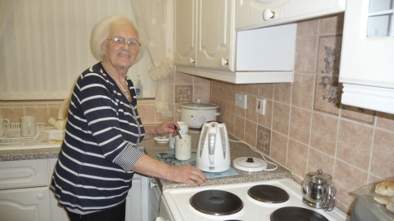
ACS-UK: Data analysis & Findings
Means and standard deviations were calculated for all items:
The most common activities that UK older people had participated in over the past year (Round 1)
The most common activities perceived for UK older people (Round 2)
Activity items with mean values of < 2.0 (the equivalent of participating ‘less than once a year or never’ in Round 1 or ‘Rare or no participation’ in Round 2) were considered for removal.
Tables drawn up: activities ranked above this cut-off point at the end of Rounds 1 and 2
Notes:
During Round 2 a number of activities were identified that either needed rewording or participants thought could be combined with other activities to reduce the number of items (identified in bold in Table 2). Participants suggested items that could be encompassed under broader headings, for example: ‘Paying household bills’ is an element of ‘Managing Financial matters’; ‘Walking the dog’ is an aspect of ‘Taking care of pets;’ and ‘Going to family gatherings’ was removed as it was considered to be included in other items, such as ‘Spending time with family / friends’, ‘Going to Parties’ or ‘Attending celebrations / ceremonies’. Participants advised several items could be combined, for example: ‘listening to radio / music’; ‘Maintaining the garden / tending your allotment’; ‘Going on holiday / travelling’; and ‘Researching family / local history.’ In one case an item ‘Gambling’ (which included playing the lottery, bingo, placing a bet, and going to a casino) was considered too broad and was expanded to form two separate items: ‘Gambling’ and ‘Playing Bingo’. Where activities could be eliminated in one round and not the other, item standard deviations were reviewed to consider variance, focus group transcripts were consulted and the authors considered societal trends which may impact older people’s activities in future. For example, working in paid employment was included in the ACS-UK because of planned increases in retirement age for UK employees (The Pensions Act 2011). Fishing was included because Round 2 participants indicated it was salient to the older UK male population; as both samples contained a higher proportion of female participants there was a possibility data might not have adequately represented a male perspective. The item ‘Dating / companion seeking’ was included owing to research that projects a significant increase in internet-based social networking amongst adults (Stroud, 2008). A total of 91 items were included in the final version of the ACS-UK (See Table 4: available as supplemental material in the PDF version of this article).

Slide 42
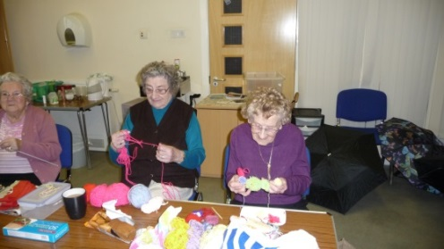
ACS-UK: Data analysis & Findings
Eight of the 20 activities identified as additional potential activity items in Round 1 obtained means above 2 in Round 2.
These were:
voting
travelling
cultural visits (which encompassed visits to National Trust or English Heritage sites, castles and country houses)
attending a hobby / leisure activity group
attending a social group
researching local history
performing charitable acts
and attending a night class / adult education group
Notes:
During Round 2 a number of activities were identified that either needed rewording or participants thought could be combined with other activities to reduce the number of items (identified in bold in Table 2). Participants suggested items that could be encompassed under broader headings, for example: ‘Paying household bills’ is an element of ‘Managing Financial matters’; ‘Walking the dog’ is an aspect of ‘Taking care of pets;’ and ‘Going to family gatherings’ was removed as it was considered to be included in other items, such as ‘Spending time with family / friends’, ‘Going to Parties’ or ‘Attending celebrations / ceremonies’. Participants advised several items could be combined, for example: ‘listening to radio / music’; ‘Maintaining the garden / tending your allotment’; ‘Going on holiday / travelling’; and ‘Researching family / local history.’ In one case an item ‘Gambling’ (which included playing the lottery, bingo, placing a bet, and going to a casino) was considered too broad and was expanded to form two separate items: ‘Gambling’ and ‘Playing Bingo’. Where activities could be eliminated in one round and not the other, item standard deviations were reviewed to consider variance, focus group transcripts were consulted and the authors considered societal trends which may impact older people’s activities in future. For example, working in paid employment was included in the ACS-UK because of planned increases in retirement age for UK employees (The Pensions Act 2011). Fishing was included because Round 2 participants indicated it was salient to the older UK male population; as both samples contained a higher proportion of female participants there was a possibility data might not have adequately represented a male perspective. The item ‘Dating / companion seeking’ was included owing to research that projects a significant increase in internet-based social networking amongst adults (Stroud, 2008). A total of 91 items were included in the final version of the ACS-UK (See Table 4: available as supplemental material in the PDF version of this article).

Slide 43
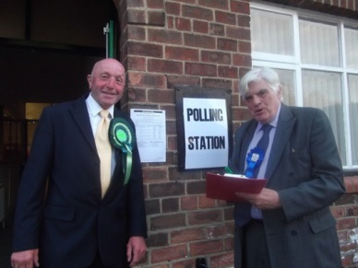
Activity Card Sort – United Kingdom (ACS-UK)
91 Activity items were grouped under four categories:
  instrumental activities of daily living (n = 27)
  high demand leisure activities (n = 15)
  low demand leisure activities (n = 25)
  and social / cultural activities (n = 24)
Notes:
1 hr 40

Slide 44
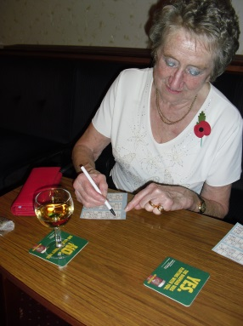
ACS-UK study: Findings
The ACS-UK has seven items not included in other ACS versions
  being on a committee
  voting
  keeping a diary / calendar of events
  relaxing / meditating
  attending a leisure / hobby group
  going for drinks at pubs / social clubs
  attending a night class / adult education group

Slide 45
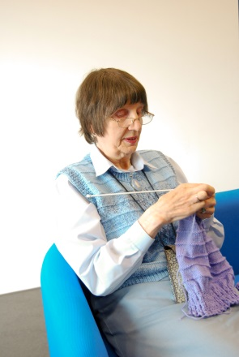
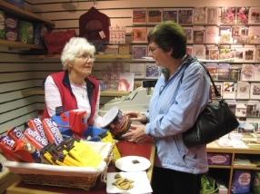
ACS-UK study: Findings
Unlikely that these activities are unique to older people in the UK; voting, for example, should be applicable to older people in other democratic countries.
Literature on other ACS versions does not comprehensively detail activities that have not met the cut-off criteria for inclusion it is not possible to establish whether these seven ACS-UK items have been considered for inclusion in any other ACS versions.
ACS versions do not attempt to include an exhaustive number of activities, but rather activities that are the most common within a specific culture.

Slide 46

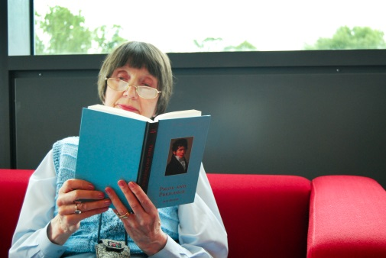
Findings
ACS (Baum & Edwards, 2008) item ‘Reading magazines / books’ was separated into two items for the ACS-UK following feedback from people with dementia (Laver-Fawcett, 2012) who found this combined activity item difficult to categorize
They explained that owing to short term memory problems they were unable to remember the plot or characters required to read books, but were still able to read magazines.

Slide 47
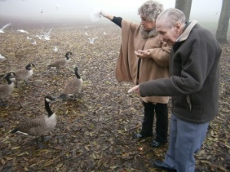
ACS-UK study: Findings
In both the ACS (Baum & Edwards, 2008) and A-ACS (Hamed et al, 2011) there is a ‘Dating / spending time with friends’ item
Results from the ACS-UK study led to ‘spending time with friends’ being grouped with ‘spending time with family’ (ACS-UK item ‘Spending time with Family / Friends’)
Dating or seeking a companion was seen by UK participants as a different activity and forms a separate ACS-UK item: ‘Dating / Companion seeking’.

Slide 48

Example ACS-UK activity card
Using a Computer ACS-UK
Notes:
1 hr 45

Slide 49
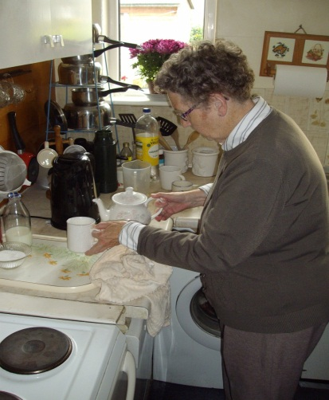

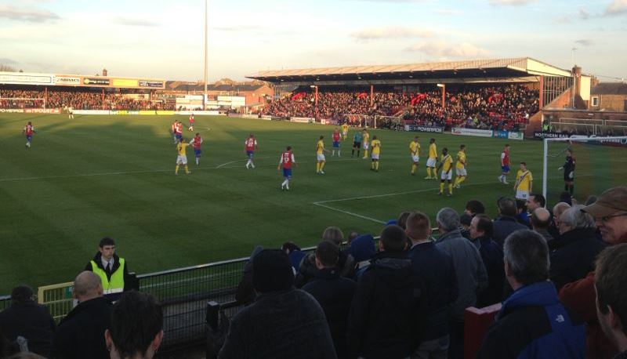
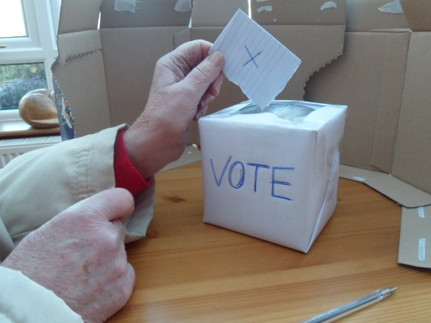
Photographing the activities
91 ACS-UK photo cards items
First photographs were reviewed by occupational therapists at the Retreat Hospital
Going to watch a sports event
ACS-UK: 30
Preparing a hot drink
ACS-UK: 20
Voting
ACS-UK: 79

Slide 50
So what is Reliability?
Reliability refers to the stability of test scores overtime and across different examiners
(de Clive-Lowe, 1996)
Repeatability: how consistently an assessment can repeat results over time.

Slide 51
Reliability
There are several types of reliability. The relevance of a particular reliability study depends on the purpose of the assessment.
Inter-rater and test-retest reliability studies are quantitative, correlation design
Non-experimental, with data collected on two or more variables and the relationship explored
(Grady and Wallston as cited in Sim and Wright, 2000 p70)
Seek to establish the relationship between different test administrators or the time between assessments.

Slide 52
Why is reliability important to occupational therapists?
The implications of false positive and false negative results
The implications of not detecting clinically important change
How much error is acceptable?
Error owing to practice effects
Error owing to rater (therapist) variation in test administration and scoring

Slide 53
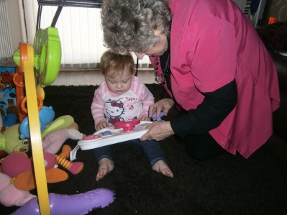
Reliability study: Students as Co-Researchers (SCoRe)
12 x 3rd year BHSc(Hons) Occupational Therapy students
Collaborated in this study for their final year project
Focus is on students and tutors collaborating in a research team
Provides students with an experience of gaining ethical approval, participant recruitment and consent procedures, administering and scoring the ACS-UK, conducting a semi-structured interview, transcribing and data analysis.
Pedagogic drivers = Research informed Teaching (RiT) and Enquiry Based Learning (EBL).
Professional drivers = evidence based practice
Level 3 module in our new curriculum ‘Contributing to the Evidence Base’
Assignment 5000 word written assignment in the format of a BJOT article

Slide 54
Acknowledgements for the Reliability study
With thanks to:
The 34 participants who gave up their time to participate in this study
Maria Pickard (Occupational Therapist at Age UK) who gave her full supported and acted as gate keeper
The staff and volunteers at Age UK who assisted with participant recruitment
The students 2014/15 who collected the data from sample 1: Kris Barker, Oliver Black, Claire Buckley, Jonathan Jackson, Alice Lloyd-Jones, Kari Milsom and Lucy Thomas.
The students 2015/16 who collected the data from sample 2: Dritero Kastrati, Christine Mueller, Philippa Price and Sophie Storr support

Slide 55
Sample and method
A convenience sample was recruited through local community organisations. Sample 1 and 2 comprised 17 participants in each sample (total N = 34)
Participants completed the ACS-UK three times.
To establish inter-rater reliability ACS-UK was administered twice on the first day, by two different student researchers.
To establish test-retest reliability, it was administered the third time, by the first student, approximately two weeks later.

Slide 56
 | Sample 1 |  | Sample 2
Variable | Total | % (2.d.p) | Total | % (2.d.p.)
Gender:
Male | 2 | 11.80 | 2 | 11.80
Female | 15 | 88.20 | 15 | 88.20
Marital Status:
Single | 3 | 17.65 | 3 | 17.65
Married | 3 | 17.65 | 2 | 11.80
Divorced | 0 | 0 | 1 | 5.88
Separated | 0 | 0 | 0 | 0
Widowed | 11 | 64.70 | 11 | 64.70
Cohabiting | 0 | 0 | 0 | 0
Other | 0 | 0 | 0 | 0
Age:
Mean (s.d.) | 85.2 (7.6) |  | 81.5 (10.2)
Highest Level of Qualifications:
No qualifications | 13 | 76.47 | 12 | 70.59
GCSE or equivalent | 1 | 5.88 | 3 | 17.65
A-level or equivalent | 1 | 5.88 | 0 | 0
Apprenticeship | 1 | 5.88 | 0 | 0
Vocational Training | 0 | 0 | 2 | 11.77
Undergraduate Degree or Graduate education | 1 | 5.88 | 0 | 0
Post-graduate education | 0 |  | 0 | 0
Ethnic Origin:
Asian or Asian British | 0 | 0 | 0 | 0
Mixed origin | 0 | 0 | 0 | 0
Black or Black British | 0 | 0 | 0 | 0
White or White British | 17 | 100 | 17 | 100
Chinese or other ethnic group | 0 | 0 | 0 | 0
Illnesses/ Health conditions/ Disability:
No | N/A | N/A | 6 | 35.29
Yes | N/A | N/A | 11 | 64.71
Reliability study
Demographic
variables for
Samples 1 & 2

Slide 57
Test retest and Inter-rater reliability of the ACS-UK
Analysis: intraclass correlation coefficients (ICC) from a one-way ANOVA random
effects model between Test 1 and Test 2 (after two weeks). ICC<.75 = poor to moderate
and r ≥ .75 = good to excellent reliability. (Bowers, 2014; Portney and Watkins, 2009)
 | Inter-rater |  |  |  | Test-retest
 |  | 95% confidence interval |  |  |  | 95% confidence interval
 | Single measure ICC | Lower bound | Upper bound | p value | Single measure ICC | Lower bound | Upper bound | p value
Sample 1
Global | 0.641 | 0.004 | 0.914 | 0.024 | 0.754 | 0.422 | 0.909 | 0.000
IADL | 0.705 | 0.121 | 0.932 | 0.012 | 0.890 | 0.712 | 0.961 | 0.000
LDL | 0.564 | -0.116 | 0.892 | 0.047 | 0.395 | -0.113 | 0.743 | 0.060
HDL | 0.625 | -0.022 | 0.910 | 0.028 | 0.450 | -0.046 | 0.772 | 0.036
SC | 0.329 | -0.391 | 0.813 | 0.179 | 0.866 | 0.655 | 0.952 | 0.000
Sample 2
Global | 0.859 | 0.579 | 0.960 | 0.000 | 0.830 | 0.507 | 0.951 | 0.000
IADL | 0.915 | 0.730 | 0.976 | 0.000 | 0.840 | 0.570 | 0.948 | 0.000
LDL | 0.554 | -0.006 | 0.855 | 0.026 | 0.840 | 0.570 | 0.948 | 0.000
HDL | 0.554 | -0.006 | 0.855 | 0.026 | 0.853 | 0.600 | 0.952 | 0.000
SC | 0.830 | 0.507 | 0.951 | 0.000 | 0.667 | 0.228 | 0.884 | 0.004

Slide 58
Mean, Standard Deviation and Range of the Percentage Agreement of
the ACS-UK 5 most important activities
Sample 1
 | Mean (%) | Standard Deviation (%) | Range (%)
Tests 1 and 2 | 56.67 | 42.74 | 0 | 100
Tests 1 and 3 | 39.36 | 31.06 | 0 | 100
Tests 2 and 3 | 55 | 44.35 | 0 | 100
Sample 2
Tests 1 and 2 | 38.17 | 25.68 | 0 | 80
Tests 1 and 3 | 36.39 | 30.73 | 0 | 100
Tests 2 and 3 | 40.63 | 20.78 | 20 | 80

Slide 59
Retained Activity Scores of the ACS-UK for Samples 1 and 2
Sample 1
 | Mean (%) | Standard Deviation (%) | Range (%)
Global | 62.45 | 16.00 | 41 | 98.1
Instrumental | 59.05 | 17.24 | 25 | 100
LDL | 69.76 | 16.12 | 50 | 100
HDL | 45.96 | 22.67 | 9 | 83.3
Social/Cultural | 60.18 | 18.02 | 42.8 | 100
Sample 2
Global | 62.75 | 11.15 | 41.6 | 84.1
Instrumental | 64.00 | 14.86 | 32.6 | 87.5
LDL | 68.98 | 13.36 | 47.9 | 90.5
HDL | 45.34 | 16.43 | 18.2 | 75
Social/Cultural | 62.58 | 16.95 | 35.7 | 87.5

Slide 60
Results summary
The inter-rater and test-retest reliability findings suggest that the ACS-UK has good to excellent reliability with single measure Interclass Correlation Coefficient figures ranging from 0.64 to 0.86 for the Global Retained Activity Scores (GRAS) of inter-rater reliability and 0.754 to 0.830 of test-retest reliability for Sample 1 and 2 respectively
The mean retained activity percentage of the GRAS of Sample 2 was 62.75% which is slightly higher than the mean of GRAS for Sample 1 (62.45%)
The mean for the top five activities for Sample 1 ranged from 39.36% to 56.67%. For Sample 2 the mean ranged from 38.17% to 40.63%
The results of this study demonstrate that the ACS-UK is a reliable, robust and client-centred assessment tool that can be used by occupational therapists, to detect participation restrictions in older British adults.
The study highlighted that the top five activities should only be used as a starting point for practitioners to collaboratively decide on what activities can potentially be used to aid therapy.

Slide 61
Limitations and future research
Convenience sample was homogeneous in terms of participants of varying ethnicities, as all participants were white British which consequently is not a full representation of the diversity of the UK’s older population (Office for National Statistics, 2011).
Sampling strategy may have led to a biased sample because the majority of people who attend AGE-UK groups may be more engaged in some activities than people who do not, within this age group.
Future ACS-UK studies should recruit participants from the wider community (e.g. from community centres, religious groups, coffee mornings, libraries and individuals’ homes)
Only the community living version (Form C) of the ACS-UK was investigated
Evaluation of the reliability of the ACS-UK Institutional version (Form A) and Recovery version (Form B) is required

Slide 62
Face validity and clinical utility study: Students as Co-Researchers (SCoRe)
8 x 3rd year BHSc(Hons) Occupational Therapy students collaborated in this study for their final year project
Laver-Fawcett A, Brain L, Brodie C, Cardy L and Manaton L. (in press) The Face Validity and Clinical Utility of the Activity Card Sort – United Kingdom (ACS-UK). British Journal of Occupational Therapy

Slide 63
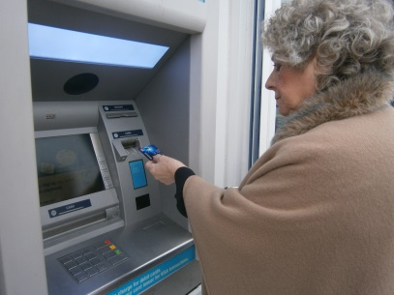
Acknowledgments
Data was collected through two dissertation projects undertaken by undergraduate occupational therapy students in the academic years 2011-12 and 2012-13.
Grateful thanks to the 27 participants who gave up their time to participate in the data collection and the people who supported the recruitment of participants.
The four occupational therapy undergraduate students who collected data during the 2nd study: Leanne Brain, Courtney Brody, Lauren Cardy and Lisa Manaton
The four occupational therapy undergraduate students who collected data during the 1st face validity and clinical utility study: Jessica Harrison, Hannah Lewis, Lucy Shaw and Debbie Agar (nee Smith).

Slide 64

Objectives
Determine the time required to administer and score the ACS-UK (duration - clinical utility)
Explore the ease of use of the ACS-UK for the people administering the assessment - occupational therapy students considering their future practice (clinical utility)
Explore the acceptability of the ACS-UK to community dwelling older people (face validity and clinical utility)
Measure the ACS-UK Global Activity Retention Scores among community dwelling older people.

Slide 65
Clinical Utility
Ease of use
Cost
Portability
Interpretability of results
Time taken to complete administration and scoring
Equipment/ items needed to complete it
Level of skill required to complete it (do you need additional training)
The amount of participation required by the client
Acceptability to the practice setting and the client group (language and culture)

Slide 66
Face validity
whether a test seems to measure what it is intended to measure (Asher, 1996)
in particular face validity concerns the acceptability of a test to the test-taker (Anastasi, 1988).
Test is acceptable to:
the test-taker (service user)
Clinicians and managers who decide on its use
people who look at the results
Usually evaluated through a survey method, e.g. interviews or questionnaires

Slide 67
Method - interview
Mixed methods approach (Creswell and Plano Clark, 2011)
ACS-UK was administered, scores obtained for: Current Activity (CA), Previous Activity (PA) and Retained Activity (RA)
Time taken to administer and score the ACS-UK (in seconds)
A semi-structured interview was developed to explore aspects of face validity, content validity and clinical utility
Open ended questions were used to allow participants to state opinions and explore ideas further
Students carried out interviews in pairs for consistency
Interviews were audio recorded and transcribed verb

Slide 68
Interview questions
What are your first impressions of the Activity Card Sort?
Did you find the assessment straightforward to carry out?
How easy were the instructions to follow, in relation to:
    Categories make sense
    Sorting the cards
    Choosing 5 most important / favourite activities
What do you think the purpose of this assessment is?

Slide 69
Interview questions (continued)
Do the photographs look like the activities they are representing?
Do the descriptions match the pictures on the cards?
Have we missed any activities that you know older people participate in?
What do you think about the time it took to complete the assessment?
Was there anything you didn’t like about the assessment?
Is there any way we can improve the assessment?
Do you have any additional comments you would like to make?

Slide 70

Sample
27 White British participants (16 women; 11 men) aged 65 or over.
Convenience Sample (recruited through local community centres, religious groups, coffee mornings, libraries and contacts known to the researchers)
Community dwelling older adults (not living in a residential or nursing home)
over the age of 65
who could comprehend and communicate in English (the project did not have the resources for translation and the ACS-UK activity labels on cards are written in English)
had capacity to provide informed consent (according to the Mental Capacity Act 2005 (English legislation)
Exclusion criteria: people who were currently receiving secondary health care or social services
Participants could be receiving check-ups/ routine care from their General Practitioner (e.g. seasonal flu jabs)

Slide 71
Qualitative Findings (n = 27)
6 found it: ‘interesting’ and / or ‘straightforward’
10 participants reported the ACS-UK was ‘good’ or ‘very good’
‘amusing’ and ‘enlightening’ (P1)
Views of the ACS-UK (question 1)
‘fine’ but it ‘did not cover every eventuality’ (P11).
‘confusing’ (P2)
‘widespread’ (P12)
‘well organised’ (P23)
‘very detailed’ (P8)

Slide 72
Qualitative Findings (n =23 )
100% agreed the ACS-UK instructions were easy to follow
85% (n = 23) stated the ACS-UK was easy and straightforward to do
4 participants were unsure where certain cards should be placed
Completing the ACS-UK (questions 2 and 3)
2 had difficulty sorting item 80 ‘being with your spouse or partner’ (they were widowed)
3 had difficulty deciding which 5 activities to choose as their most important
9 said sorting category labels made sense; ‘there couldn’t be any more alternatives’ (P25)

Slide 73
Qualitative Findings
help with student studies (n=2)
‘to test the level of intelligence for the age group’ (P24)
37% (n = 10) thought the assessment was related to age
‘to see if old age is setting in’ (P22)
48% (n = 13) thought the assessment was to ‘see what people over 65 do with their lives’ (P23)
Purpose of the Assessment (question 4)
‘accounting for people’s age and what their mind is like’ (P15)
‘to develop some sort of a system to help people come back into normal life’ (P20).
unsure of the purpose of the assessment
(n = 2)

Slide 74
Qualitative Findings (n = 26)
N = 2: age range of people in the photographs noting that they ‘showed people a lot older than 65’ (P19)
100% the photographs looked like the activities they were depicting
Views of the Activity Items (questions 5, 6 and 7)
96% agreed the activity labels matched the photographs on the cards
81% no activities that older people engage in had been missed
Missing items: ‘volunteering with people’ (P18); ‘sleeping’ (P7); ‘football’ (P14); ‘jigsaws’ (P14, P26); and ‘playing an instrument’ (P16)

Slide 75
Qual. Findings (n = 26)
92.6% agreed the time to complete the assessment was reasonable
‘very quick’ (P24)
Time taken (question 8)
‘shorter than I thought it would be’ (P19)
‘just right’ (P21)
‘didn’t take long’ (P3)
Notes:
The remaining participant discussed the ease of the assessment but did not comment specifically on the time taken.

Slide 76
Qual. Findings
N = 1: pictures did not represent 65 year olds
70% could not think of any way to make the assessment better
89% did not identify anything they did not like about the assessment
some photographs did not present people physically doing the activities
Suggestions to improve the assessment
(questions 9, 10 and 11)
P16 was
unsure of the purpose of the assessment and so felt unable to answer question
Suggestion for further sorting categories : ‘wish I could do’ (P18); ‘aims for the future’ (P18); ‘not applicable’ (P3); ‘not often’ (P7); and ‘sometimes’ (P7)

Slide 77
Discussion: qualitative findings
Feedback from study | Consideration | Decision
ACS-UK item 80 ‘Being with your spouse / partner’ difficult to categorise for some participants | Identified as problematic for participants who had been widowed | Manual will suggest that therapists could remove this item if they are aware that the client has been widowed, divorced or separated
Most difficult aspect of the assessment appeared to be choosing five most important activities | ACS-NL (Jong et al., 2012) has four overview cards which show smaller size photographs of all activity items for each domain on one sheet. | Overview sheets showing all the ACS-UK IADL, LDL, HDL and SC activities have now been produced

Slide 78
Discussion: qualitative findings
Feedback from study | Consideration | Decision
Items that cover a number of activities, such as ‘Managing financial matters’, need more clarity | Consider having more than one photograph on a card or add some examples in brackets under the activity label | To review combined activities and add examples
Two participants who were under 70 years old commented that most of the people in the photographs appeared quite a bit older than 65 years. | As the assessment is for people aged 65 and over it is important that the photographs included are representative of the whole age group. | Several items have now been re-photographed to show people under 70 completing activities
Several participants were unsure of the purpose or had not correctly identified the reason for the assessment | It is important that people fully understand the purpose of an assessment | More detailed guidelines provided in the ACS-UK test manual to instruct therapists how to explain the purpose of the ACS to clients

Slide 79
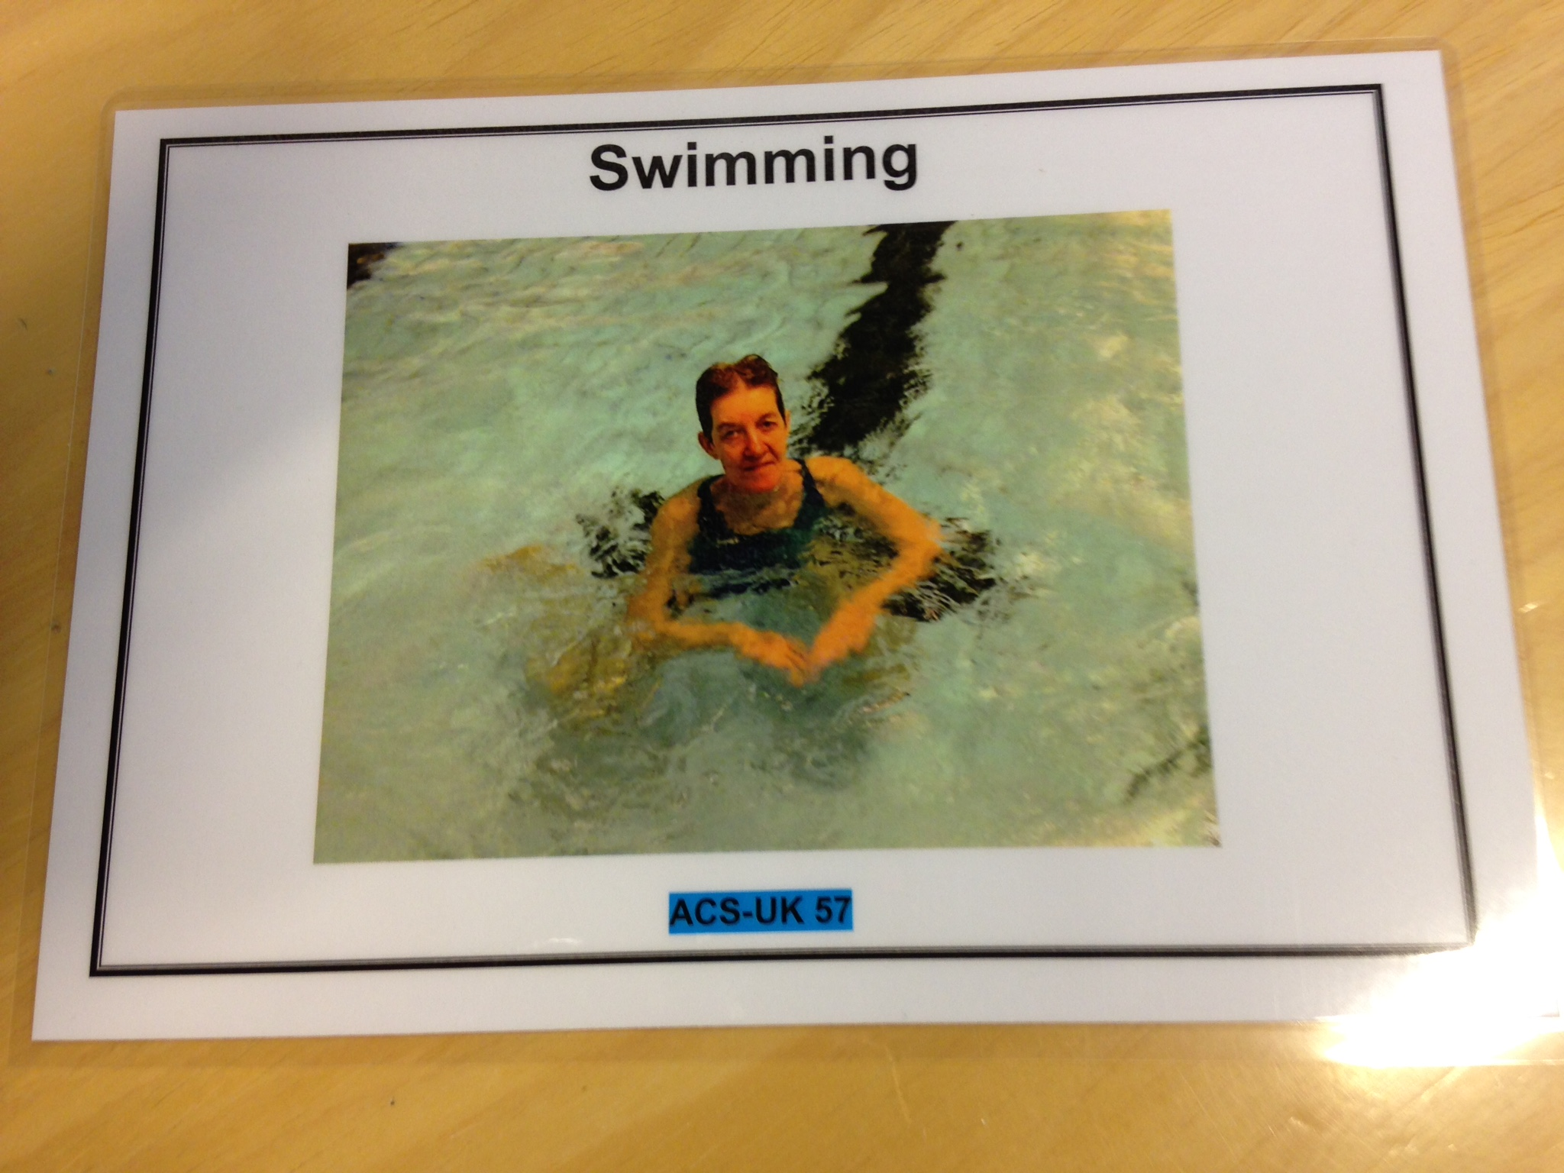
Example of a re-photographed activity

Slide 80
Feedback from study | Consideration | Decision
Add an item for sleeping (n = 1) | The ACS-UK item 15 ‘Taking a rest’ shows someone sitting on a sofa with her eyes closed. Literature review – sleeping as an occupation | Item for ‘Sleeping’ to be added
Add an item to represent volunteering with people (n = 1) to show an active role of volunteering such as working with children or adults | ACS-UK item 78 ‘Volunteer Work’ can include a wider range of volunteering activities | Further written examples in brackets will be added to item 78
Add item for ‘playing an instrument’ (n = 1) | Playing instrument had not met the cut-off level for inclusion during content validity study | If the person mentions playing a n instrument this can be added as an ‘other’ activity

Slide 81
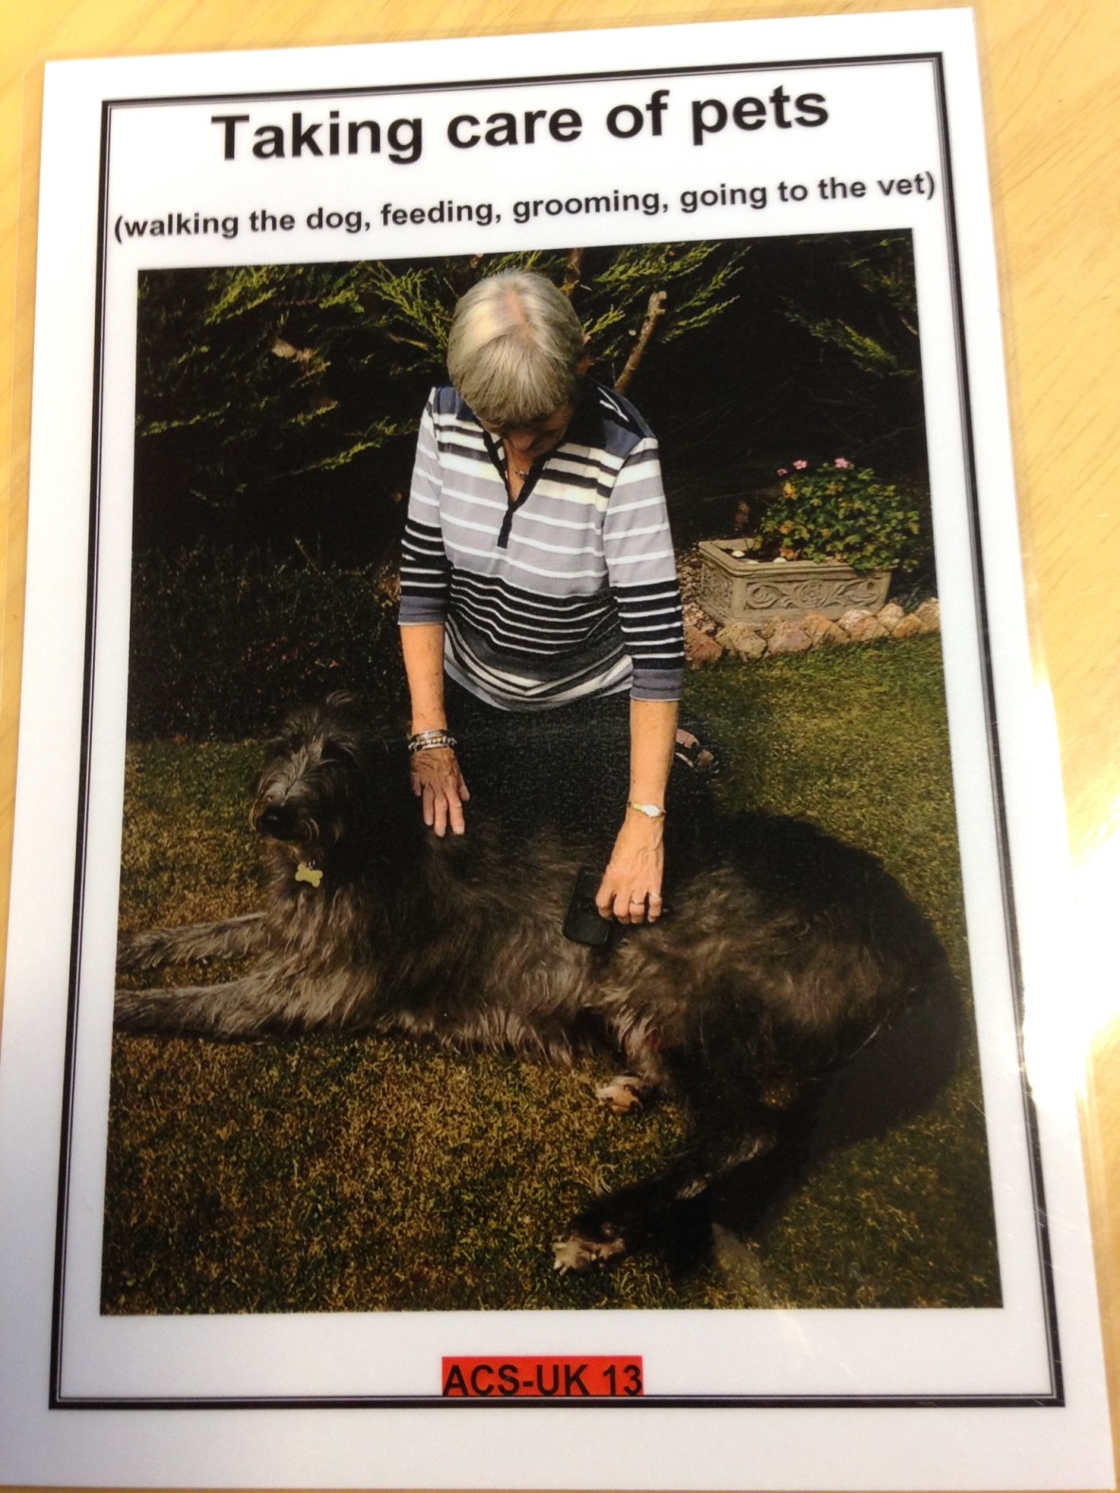
Further written examples in
brackets have been added
for several ACS-UK items
This is an example of additional
descriptions for:
Taking Care of Pets (ACS-UK 13)

Slide 82
Discussion: qualitative findings
Feedback from study | Consideration | Decision
Add an item for doing jigsaw puzzles (n = 2) | In content validity study ‘Putting together puzzles’ had mean frequency above the cut-off during Round 1. But had been combined: item 32 ‘Doing Puzzles / Crosswords’ | New item ‘Doing Jigsaws’ has been added as ACS-UK item in the Low Demand Leisure domain.
Football was not included (n = 1); playing or watching football? | Item 30 ‘Going to watch a sports event’ and item 62 ‘Exercising’ | Further written examples in brackets will be added to item 62. Do people perceive participating in team games, such as football, as ‘exercise’?

Slide 83
Qualitative findings: Summary of data for time taken to score the ACS-UK
Sample | Range in seconds (minutes and seconds) | Mean in seconds (mins and secs) | Standard deviation (seconds)
Sample 1 (n = 16) | 208-368 (3 m 28 s – 6 m 8 s) | 277 (4 m 37 s) | 47
Sample 2 (n = 11) | 255-415 (4 m 15 s – 6 m 55 s) | 310 (5 m 10 s) | 50
Combined sample (N = 27) | 208-415 (3 m 28 s – 6 m 55 s) | 290 (4 m 50 s) | 50

Slide 84
Table 2: Summary of data for time taken to administer the ACS-UK
(n =11 participants and 4 assessors)
Sample | Range in seconds (minutes and seconds) | Mean in seconds (mins and secs) | Standard deviation (seconds)
Sample 2 | 290-1020 (4 m 50 s – 17 m) | 581 (9 m 41 s) | 225 (3 m 45 s)
Mean time for administering and for scoring the ACS-UK was combined
The average duration was 14 minutes 31 seconds

Slide 85
Discussion: duration
Despite having the most items of any ACS versions, the average time for administering and scoring the ACS-UK was approx.14 ½ minutes
longest scoring time < 7 minutes
longest administration time was 17 minutes
total assessment time approx. 24 minutes
total ACS-UK time was 4 minutes longer than the 20 minutes reported for the ACS-HK (Chan et al., 2006) and ACS (Baum and Edwards, 2008)

Slide 86
Discussion: duration
ACS-UK was less time consuming than the Israeli ACS
Katz et al. (2003) reported I-ACS took between 30-60 minutes
However, Katz et al. undertook a discriminant validity study with healthy adults and older adults, caregivers and people with Alzheimer’s, stroke, or multiple sclerosis.
It may be that test administration will take longer with some client groups.

Slide 87
Summary of ACS-UK Retained Activity Scores
Domain | Range (%) | Mean (%) | Standard deviation (%)
Global Retained Activity Score (GRAS) | 51.09 - 89.47 | 70.10 | 10.32
Instrumental Activities of Daily Living (IADL) RAS | 66.00 - 95.83 | 79.36 | 8.42
Low Demand Leisure (LDL) RAS | 36.84 - 96.66 | 71.78 | 14.19
High Demand Leisure (HDL) RAS | 12.50 – 100 | 57.41 | 20.27
Social / Cultural (SC) RAS | 28.94 - 85.71 | 63.49 | 14.60

Slide 88
Limitations and future research
This study involved a small convenience sample of White British older adults.
It would be beneficial to conduct a further study with a more ethnically diverse sample that better represents the UK older adult population.

Slide 89
Limitations and future research
As a number of changes are being made to the ACS-UK in response to the results of this study, it would be useful to evaluate whether the changes lead to improved face validity with another sample.
Katz et al (2003) examined the differences in activity participation between men and women and a secondary analysis examining Retained Activity Scores and Global Retained Activity Scores by gender of the ACS-UK scores obtained by this sample would be useful.

Slide 90

Conclusion
The study showed that overall the ACS-UK has good acceptability and utility in terms of older adult’s first impressions, ease of understanding instructions, activities, activity labels and carrying out the card sort.
However, understanding of the purpose of the ACS-UK was varied and this aspect of face validity can only be considered as fair.
In terms of clinical utility, the reasonable time required to administer and score the ACS-UK, along with the ease of administering and scoring the assessment suggests that the ACS-UK has good clinical utility.

Slide 91
Conclusion (continued)
The study also identified potential additional activities for consideration and shed new light on some activities which were previously removed during initial test development.
A sample of ACS-UK scores for community dwelling older adults was obtained for a future discriminative validity study.

Slide 92
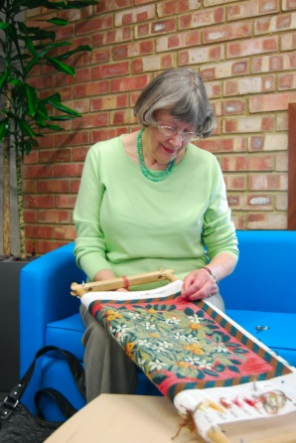
Limitations of the ACS
The ACS does not provide information regarding factors such as:
Length of time spent engaged in activities
Frequency of participation
Social interactions during activity participation
Difficulty experienced while performing an activity (Baum et al., 2000; Katz, Karpin, Lak, Furman & Hartman-Meier, 2003)
(Canadian Stroke Network – Stroke Engine Assess, n.d.)

Slide 93

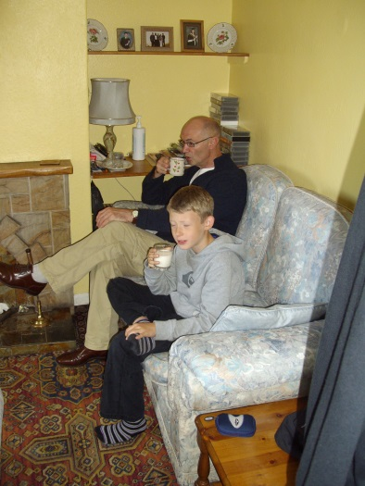
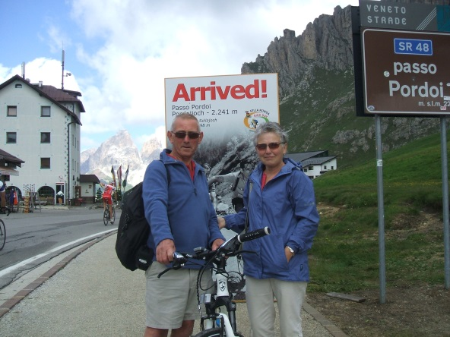
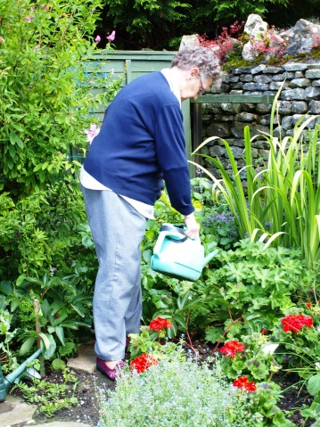
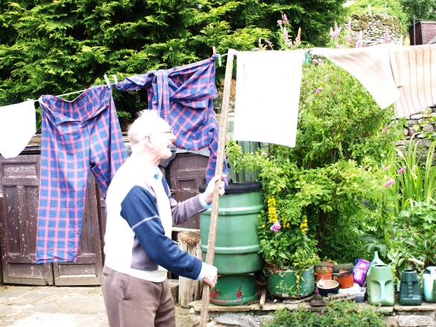
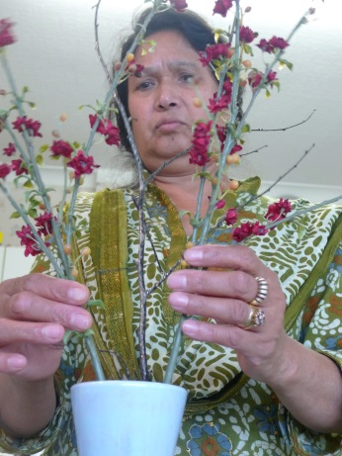
Questions and discussion

Slide 94
References
Albert, S. M., Bear-Lehman, J., & Burkhardt, A. (2009). Lifestyle-adjusted function: Variation beyond BADL and IADL competencies, Gerontologist, 49, 767-777.
Alegria A., Vila D., Woo, M., Canino G., Takeuchi D., Vera M., Febo V., Guarnaccia P., Aguilar-Gaxiola S., & Shrout P. (2004) Cultural Relevance and Equivalence in the NLAAS Instrument: Integrating Etic and Emic in the Development of Cross-Cultural Measures for a Psychiatric Epidemiology and Services Study of Latinos. International Journal of Methods in Psychiatric Research. 13(4) 270–288. [Online] Available: http://www.ncbi.nlm.nih.gov/pmc/articles/PMC2771729/ [Accessed 13 March 2014]
Ball, V., Corr, S., Knight, J., & Lowis, M. (2007). An investigation into the leisure occupations of older adults. British Journal of Occupational Therapy 70, 393-400.
Bannigan, K., & Laver-Fawcett, A. (2011) Aging, occupation and mental health: the contribution of the Research Centre for Occupation and Mental Health. WFOT Bulletin, 63, 55-60.
Baum, C. M. (1993). The effects of occupation on behaviors of persons with senile dementia of the Alzheimer’s type and their careers. Dissertation, George Warren Brown School of Social Work, Washington University, St. Louis.
Baum, C. M. (1995). The contribution of occupation to function in persons with Alzheimer’s disease. Journal of Occupational Science, 2, 59–67

Slide 95
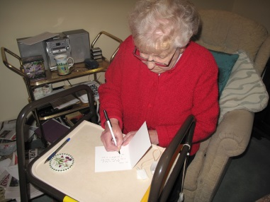
References
Baum, C. M., & Edwards, D. F. (2001). Activity Card Sort (ACS): Test manual. St Louis, MO: Penultima Press.
Baum, C. M., & Edwards, D. F. (2008). Activity Card Sort (ACS): Test manual (2nd Ed). Bethesda, MD: AOTA Press.
Baum, MC, Perlmutter, M & Edwards, D (Summer, 2000). Measuring function in Alzheimer’s Disease. Alzheimer’s Quarterly, 44-61.
Block J (1961) The Q-Sort method in personality assessment and psychiatric research. Springfield: Charles C Thomas Publisher [On-line] Available: http://abegs.org/sites/Research/DocLib1/أجنبية/The%20Q-Sort%20Method%20in%20Personality%20Assessment%20and%20Psychiatric%20Research.pdf [28th March 2014].
Chan, W. K., Chung, J., & Packer, T. L. (2006). Validity and reliability of the Activity Card Sort – Hong Kong version. OTJR: Occupation, Participation, and Health, 26, 152–158.
Chilvers, R., Corr, S., & Singlehurst, H. (2010). An Investigation into the Occupational Lives of Healthy Older People through their Use of Time. Australian Occupational Therapy Journal, 57, 24-33.
Clark F, Jackson J, Carlson M, Chou C-P, Cherry BJ, Jordan-Marsh M, et al (2011) Effectiveness of a lifestyle intervention in promoting the well-being of independently living older people: results of the Well Elderly 2 Randomized Controlled Trial. Journal of Epidemiology and community Health 66(9) 782-90. doi:10.1136/jech.2009.099754

Slide 96
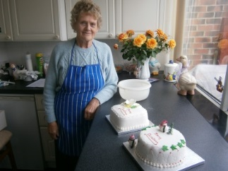
References
Creswell JW and Plano Clark VL (2011) Designing and Conducting Mixed Methods Research. 2nd ed. Thousand Oaks: Sage Publications.
Doney R. M., & Packer T. L. (2008). Measuring changes in activity participation of older Australians: Validation of the Activity Card Sort–Australia. Australasian Journal on Ageing, 27, 33–37.
Edwards, D. F., Hahn, M., Dromerick, A. W., & Baum, M. C. (2005). Race differences in function and quality of life in mild stroke. Stroke, 36, 480.
Eriksson, G. M., Chung, J. C. C., Beng, L. H., Hartman-Maeir, A., Yoo, E., Orellano, E. M., van Nes, F., DeJonge, D., & Baum, C. (2011). Occupations of older adults: A cross cultural description. OTJR: Occupation, Participation, and Health, 31(4) 182-92.
Everard, K. M., Lach, H. W., Fisher, E. B., & Baum, M. C. (2000). Relationship of activity and social support to the functional health of older adults. Journal of Gerontology: Social Sciences, 55B, S208-S212.
Hamed R., AlHeresh R., Abu Dahab S., Collins B., Fryer J., & Holm M.B. (2011). The Development of Arab Heritage Activity Card Sort (A-ACS). International Journal of Rehabilitation Research 34 (4), 299-306.

Slide 97
References
Hamed, R., & Holm M.B., (2013) Psychometric Properties of the Arab Heritage Activity Card Sort. Occupational Therapy International, 20, 23-34.
Hartman-Maeir A, Soroker N, Ring H, Avni N, Katz N (2007) Activities, participation and satisfaction one-year post stroke. Disability Rehabilitation, 29(7): 559-66
Jong AM, van Nes FA, Lindeboom R. (2012) The Dutch Activity Card Sort institutional version was reproducible, but biased against women. Disabil Rehabil 34(18):1550-1555
Kalldalen A, Marcusson J & Wressle E (2013) Interests among older people in relation to gender, function and health related quality of life. British Journal of Occupational Therapy, 76 (2), 87-93.
Katz, N., Karpin, H., Lak, A., Furman, T., & Hartman-Maeir, A. (2003). Participation in occupational performance: Reliability and validity of the Activity Card Sort. OTJR: Occupation, Participation, and Health, 23, 10–17.
Laver-Fawcett AJ (2014) Procedure for Administering and Scoring ACS-UK Community Living version (Form C) (un-published test manual). York, York St John University (provided by author).
Laver-Fawcett A, Brain L, Brodie C, Cardy L and Manaton L. (in press) The Face Validity and Clinical Utility of the Activity Card Sort – United Kingdom (ACS-UK). British Journal of Occupational Therapy. , 79(8) 492–504.
Laver-Fawcett AJ, Mallinson S (2013) The Development of the Activity Card Sort – United Kingdom version (ACS-UK). OTJR: Occupation, Participation, and Health, 33 (3), 134-145. DOI: 10.3928/15394492-20130614-02

Slide 98
Reference:
Laver Fawcett AJ
2007
Principles of Assessment and Outcome measurement for Occupational Therapists and Physiotherapists.
Chichester:
John Wiley & Sons

Slide 99

Further reading
Book chapter
Laver-Fawcett (2012)
Psychosocial Occupational Therapy: An Evolving Practice (3rd ed)
Chapter: Assessment, evaluation and outcome measurement
Article
Laver-Fawcett, A J (2014) Routine standardised outcome measurement to evaluate the effectiveness of occupational therapy interventions: essential or optional? Ergoterapeuten, 4, 28-37

Slide 100
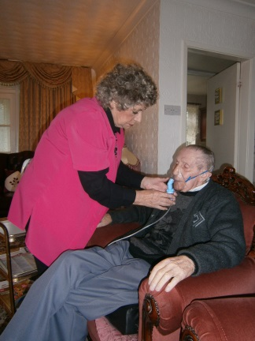
Declarations of interest:
The first author and YSJU maintains copyright of the Activity Card Sort-United Kingdom (ACS-UK). The ACS-UK manual and cards may be published for-profit in future.

Slide 101
Further Acknowledgments
Dr Katrina Bannigan who co-supervised the first sample data collection and Sarah Mallinson who provided an introduction to this student research group on the administration of the ACS-UK for the face validity and clinical utility study 2011-12.

Slide 102

Contact details
Alison J. Laver-Fawcett, PhD, O.T.(C), DipCOT, PCAP
Faculty of Health and Life Sciences
York St John University
Lord Mayor’s Walk, York
YO31 7EX
+44(0)1904-624624
a.laverfawcett@yorksj.ac.uk
www.yorksj.ac.uk
Notes:
These are my contact details

