Slide 1

A collaborative approach to research projects: Students as Co-researcher (SCoRe) projects at YSJU-Occupational Therapy
CRP
March 2017
Dr Alison Laver-Fawcett

Slide 2

Setting the scene
What research are you doing at the moment?
Are you already partnering with students in research?
What are your students studying?
Do your students do research projects already?
Do they already do projects on work placements?

Slide 3
Workshop overview
Showcase the occupational therapy approach-Students as Co-Researchers (SCoRE)
Demonstrate the impact of the SCoRE approach
Consider the landscape for student research projects
Consider how we might facilitate student engagement in research partnerships
Discuss the challenges and opportunities….

Slide 4
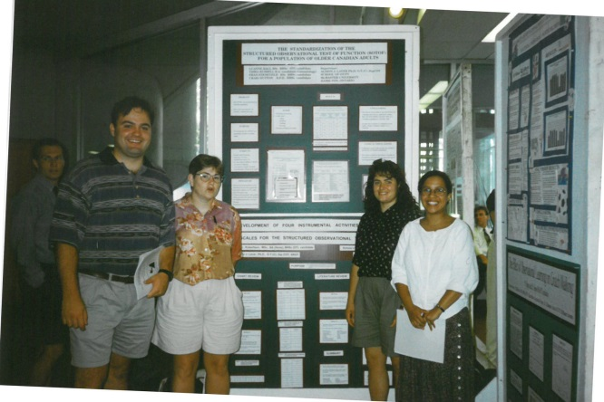
My Experience at McMaster University, Canada 1994-97
Example conference outputs with students included posters and papers at national and international conferences
Students wrote a research report and produced a poster. We had a conference attended by students, staff and invited occupational therapy clinicians.
Encouraged students to submit abstracts to local and national conferences.

Slide 5
Research informed teaching
In the BHSc(Hons) Occupation Therapy programme staff are trying to integrate all 4 RIT types
YSJU perceives research informed teaching as a pedagogic approach (Griffiths, 2004). Teaching can be:
research-led : content of what is taught is influenced directly by the research interests of the teaching staff.
research-oriented: curriculum places an emphasis on teaching students inquiry skills and understanding research methods.
research-based: curriculum is focused on students acquiring knowledge through inquiry. Students have more control over their learning and the emphasis is much less on traditional transmission of knowledge from staff to students. [YSJ Enquiry Based Learning Project 2006-9]
research-informed: The curriculum is informed by reflecting on and inquiry into teaching learning and assessment through pedagogic research and evaluation.
http://www.yorksj.ac.uk/add/add/learning-and-teaching/active-learning/research-informed-teaching.aspx

Slide 6

Framework for Student engagement through partnership
Higher of Education Academy (HEA; 2015a)

Slide 7
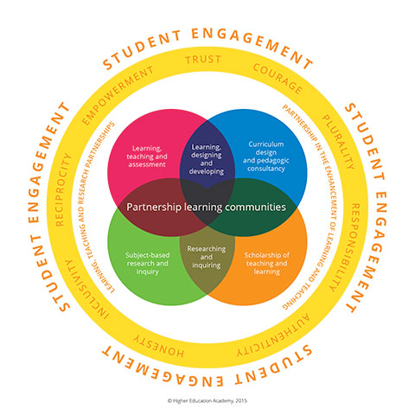
Framework for Student engagement through partnership
Higher of Education Academy (HEA; 2015a)
Partnership = a relationship in which all involved are actively engaged in, and stand to gain from, the process of learning and working together.
It enables and empowers students to engage deeply in their learning and enhancement.
For staff, working in partnership with students can help transform thinking about learning and teaching practices.
Subject based research and inquiry
https://www.heacademy.ac.uk/sites/default/files/downloads/student-enagagement-through-partnership.pdf

Slide 8

Benefits
(HEA; 2015b)

Slide 9
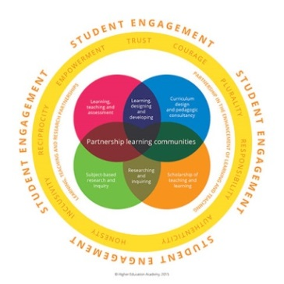
‘All undergraduate students in all higher education institutions should experience learning through, and about, research and inquiry.
In undergraduate research, students learn and are assessed in ways that come as close as possible to the experience of academic staff carrying out their disciplinary research.’
    (Healey and Jenkins, 2009)

Slide 10

Methodology and results from completed SCoRe projects are used to inform teaching across all three levels of our BHSc(Hons) Occupational Therapy programme
3OT501: Contributing to the Evidence Base
2OT503: Analysing and Applying the Evidence Base
1OT503: Understanding and Reviewing the Evidence base
3rd year
2nd year
1st year

Slide 11




Example Partners
SCoRe projects have involved a range of external partners including:
Age UK York
Alzheimer’s Society
Safe and Secure Homes (SASH)
York People First
Yorkshire and Humber Improvement Partnership (YHIP)
World Federation of Occupational Therapists
“.. particularly motivating to be part of bigger international WFOT project”
Student comment

Slide 12
How do SCoRe projects develop?
Responding to requests to support service evaluation
Responding to requests from clinicians – practice developments
Responding to policy drivers
Contributing to the development of professional guidance
Responding to needs identified from practice placements

Slide 13
How do SCoRe projects develop?
Responding to needs identified by clinical occupational therapists / services (e.g. Helen’s ‘Cook and Eat project, the peer Mentoring project with TEWV mental health trust)
SCoRE projects leading into staff research:
  E.g. SCoRe project exploring changes in the occupational engagement of people with dementia and their carers (Alison and Stephen with Alzheimer’s Society) led to the identification of the need for a UK version of the ACS-UK
  Staff project (Alison) with HLS research assistant (Sarah Mallinson) for the ACS-UK content validity study (1 year, OTJR article output)
  Followed by Score projects to evaluate the face validity and clinical utility (x 2 years) and the reliability (x2 years with 3 groups of students) of the ACS-UK
“I felt proud to be apart of a group of students who were contributing to the evidence base of the ACS-UK”
(level 3 OT student)

Slide 14
SCoRe project
Led to
Staff project
Report for World Federation of Occupational Therapists
International conference presentation:
Bannigan, K, Cronin-Davis, J, Laver-Fawcett, A, Brintnell, S. (June 2014) The WFOT global survey of mental health practice in occupational therapy. Oral Presentation. 16th International Congress of the World Federation of the World Federation of Occupational Therapists in collaboration with the 48th Japanese Occupational Therapy Congress and Expo, Yokohama, Japan. Abstract: http://wfot2014.mas-sys.com/pdf/endai200414.pdf [accessed 23.6.14]
This was delivered in English and simultaneously translated into Japanese.
We are now writing an article for publication. Revised manuscript back for review with the Australian Occupational Therapy Journal
Students undertook a literature review to inform questions for an international survey of occupational therapists’ education and practice related to mental health.
They developed an on-line survey using Survey Monkey, piloted the survey and evaluated feedback

Slide 15

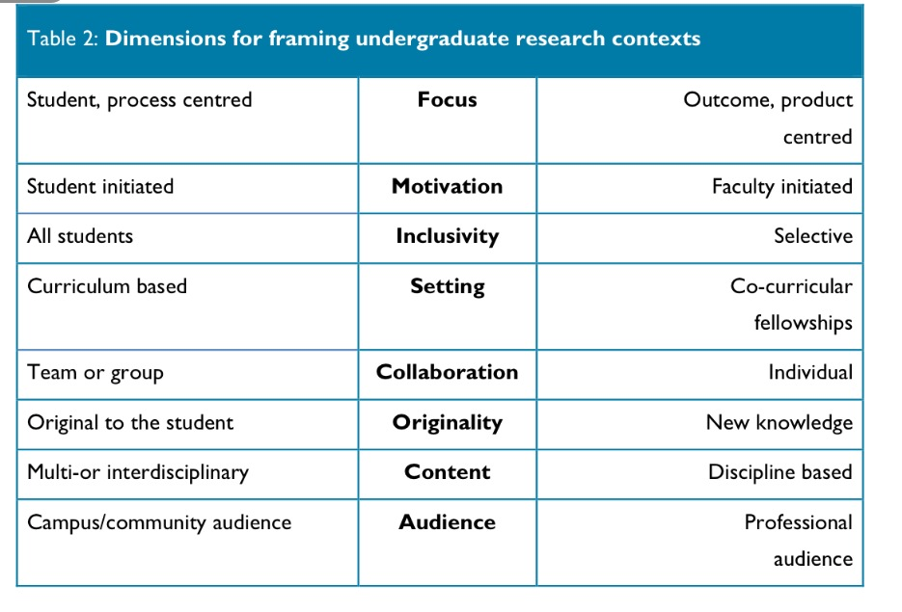

Healey, Flint and Harrington, 2014 – Applied to 3OT501
Both
Choice
Can be either
Can be either
Choice
Can be either
Can be either
Both
Some articles and presentations
Level 3 showcase
Varies

Slide 16
Students have choice: 3 types of project
Student as Co-Researcher Projects (SCoRe): – staff offer projects students can select to do, some are with external partners, often undertaken in small groups. Can be primary (range of qualitative, quantitative and mixed-methods studies - including service evaluation) or secondary research (e.g. systematised critical literature reviews).
Critical literature reviews: Student choice with a supervisor who is interested in the same topic area
Student projects: The student suggest the focus and some initial ideas for methodology. They work up their method under supervision with a staff member interested in that topic area / type of design.
Notes:
Occupational therapy staff at YSJU have been taking a Student as Co-researcher (SCoRe) approach to our OT dissertation module for several years.
Although participation in a SCoRe project is optional (students can chose to undertake an individual primary research project or Critical Literature review instead) the demand from students to engage in a group SCoRe project was higher than ever this academic year.

Slide 17

Practical considerations: allocation
Semester 2: ask staff for their projects, topics and what they are interested and willing to supervise.
A list of projects and topics offered by each OT staff member is put up on moodle
Students look through the list. They can e-mail staff directly for more information some had tutorials with staff to find out more about SCoRe projects being offered.
They then complete a form listing their choices
Submit proforma via link on moodle by given a deadline.
If they don’t submit form or its late – they are allocated last
Students chose at least 3 options and list in order of preference.

Slide 18


How we allocate projects
Takes several hours! FTE up to 7 students PT staff 4 students
Send it out to staff to review before release to students.
If more students sign up for a SCoRe project or supervisor than places available then we draw names out of a hat.
For the most popular study a staff member who had not supervised a primary SCoRe project before partnered with the original supervisor and this opened the project to more students.
I assign as many 1st choices as possible (last year over ½ cohort got 1st), then as many 2nd and 3rd choices (over a ¼).
Time consuming allocating the remainder: e.g. Students wanting to do a primary study of their own choice got to do this but maybe not with 1st-3rd choice supervisor.
If they wish students can start reading around their project topic area over the summer. Some ask for recommended reading.

Slide 19
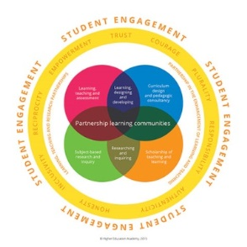
Contributing to the Evidence Base. Learning outcomes
Justify the choice of project in relation to existing evidence or practice, including research ethics
Justify the choice of methods in relation to the aims of the study
Collect, collate, analyse and present data in a professional and ethical manner
Interpret data in the context of evidence, policy and/or guidelines
Critically evaluate and synthesise concepts, theories and research in order to determine their relevance to professional practice
“It was also an extra benefit of doing the research project and gave something to work towards as well as hitting the module learning outcomes.”

Slide 20

Level 3 Module: Contributing to the evidence base:
Starts September (Semester 1), hand-in date mid February prior to final placement
5,000 word written assignment and a 250 word abstract.
The assignment is presented in the style of a journal article. Students refer to the authors' guidelines for the British Journal of Occupational Therapy (BJOT).
Journal is internationally recognised

Slide 21
Student evaluation comments:
“I am very excited about the possibility of publishing our research into the British Journal of Occupational Therapy.”
“Preparing for publication as 5000 assignment an inspired idea!”
Level 3 OT student
“With the assignment being a co-authored journal article about our research project I felt I was much more engaged ”
“Our sub-group was really motivated by possibility of a paper being published”
“I'd be really excited to turn it into a journal article for publication. …it is a great opportunity that wouldn't have been available to me without this score project. I think doing it as a journal article made sense to people and really helped me get into the project better. ”

Slide 22
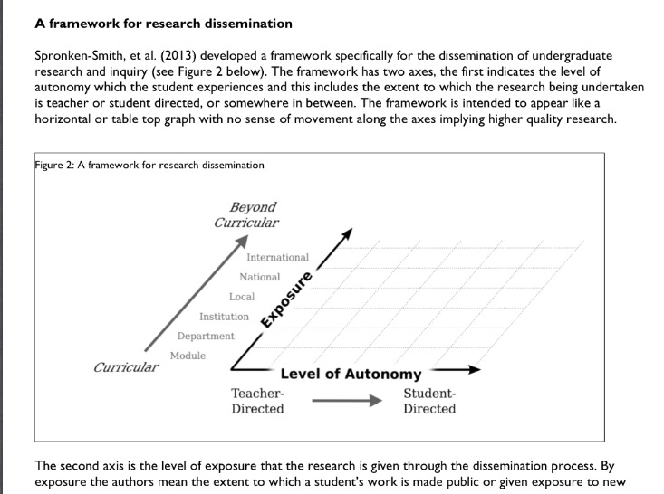
Students and staff disseminating research together
(Healey, Flint and Harrington, 2014)

Slide 23
International
WFOT, DSDC, ENOTHE & COTEC conferences
National
BJOT publication,
COT National guidance (NICE accredited)
Local
Reports for organisations,
YHIP workshop,
Local supermarkets,
Institution
YSJU Talking about teaching conference
Department
Level 3 showcase Discover event
Module
SCoRe examples used across the curriculum

Slide 24
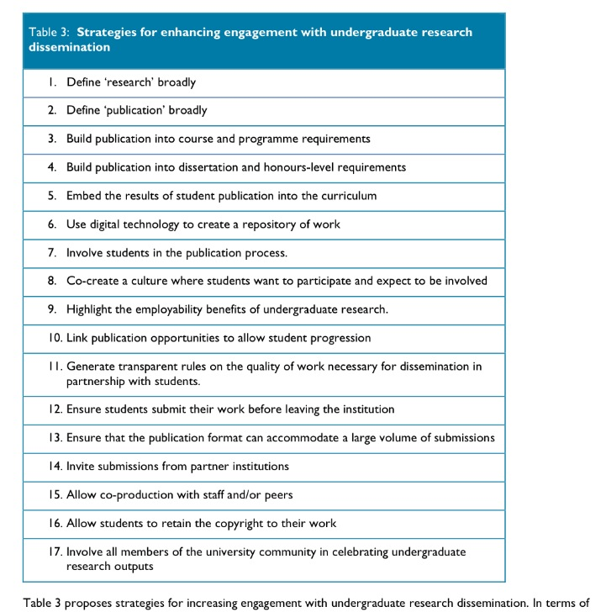
Ask students for their contact details!

Slide 25

One day event
This conference showcased 3rd year Occupational Therapy student work in the form of posters and presentations.
Attendees included Occupational Therapy students and their families, Occupational Therapy staff, Faculty and University staff, clinical educators and clinical managers.
http://www.yorksj.ac.uk/health--life-sciences/faculty-of-hls/faculty-events/discover-2016/discover-occupational-therapy.aspx

Slide 26
Dissemination: things to consider
Authorship and roles in the process should be discussed in advance.
Who should be first author?
Order of authorship?
Will the students still be invested in seeing it through after graduation?
Who will correspond with the journal?
Who will lead any revisions and responding to reviewers feedback?
Who will lead on checking the proof copy?
Student comment: “I also think that listing us in alphabetical order is most fair because I feel that we all put the same amount of effort in the written work and worked really hard during data collection, regardless of whose academic writing scores the highest marks.”

Slide 27
Things to consider
If you have a big SCoRe group how will multiple student assignments be combined into one article?
WFOT study: all the students in each sub-group and the 2 supervisors will co-author.
Aiming for three articles, one for each sub- group review (literature relates to different parts of the life course).
We will start with the assignment of the student with the highest mark but also look at the others too so we amalgamate the best of them all.
Staff will also pull together the findings for a report for WFOT
Student comment: “I am pleased about turning our assignment into a co-authored journal article. I think taking the best bits of everyone's assignments and producing one quality article will increase the chance of it getting published.”

Slide 28
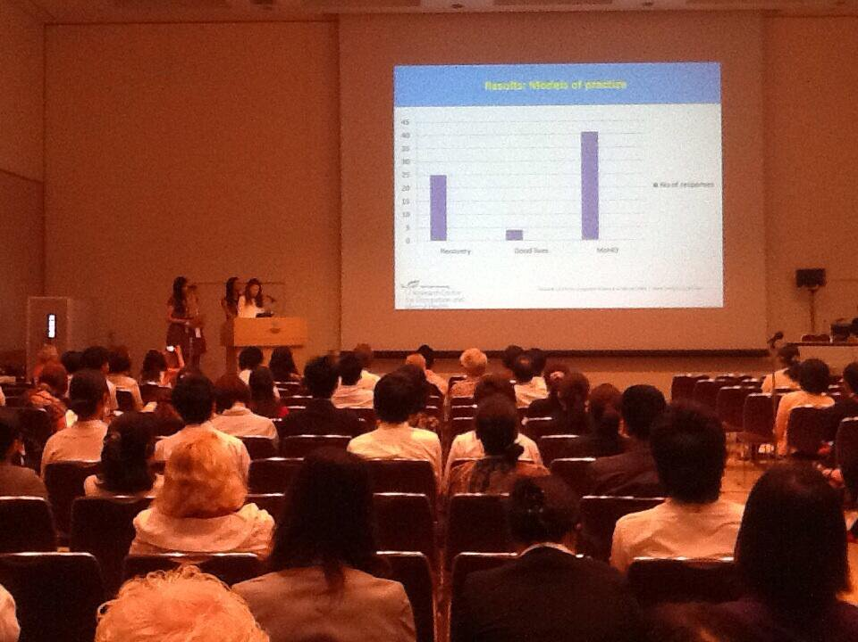
The World Federation of Occupational Therapists (WFOT) Congress 2014 in Yokohama, Japan was attended by a total of 6893 participants from 70 countries worldwide. A cross section of attendees included over 5,900 who were registered participants
4 YSJU OT graduates presenting their SCoRE project at this conference.
Students were supervised by Jane Cronin-Davis and
I was there to support them and assist with Q & A at the end of their
presentation

Slide 29


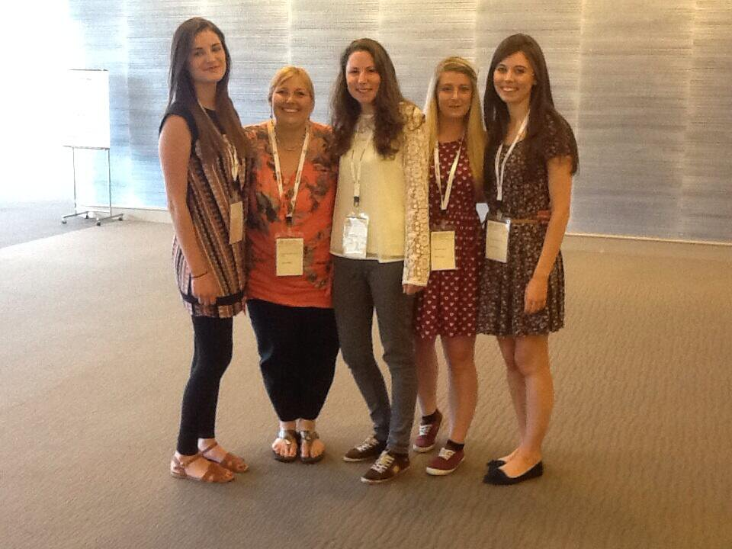
WFOT congress-Japan 2014
Cronin-Davis, J, Bennet, R, Cassidy, K, Garrick, K, Manners R (2014) Forensic mental health: a survey exploring current practice. 16th International Congress of the World Federation of the World Federation of Occupational Therapists, Yokohma, Japan

Slide 30
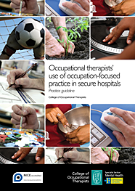
Contributing to professional guidelines
The same four students had their dissertation results included a College of Occupational Therapists (COT ;2012) guideline as evidence in the publication.
https://www.cot.co.uk/publication/practice-guidelines/occupational-therapists%E2%80%99-use-occupation-focused-practice-secure-hosp.
This guidance is NICE accredited, following a systematic review and critical appraisal of the evidence; Jane Cronin-Davis was the lead for guideline development.
Students references:
  Bennett S, Manners R (2012) An exploration of models, theories and approaches used by occupational therapists in forensic mental health. Unpublished honours dissertation: York: York St John University.
  Cassidy K, Garrick I (2012) An exploration of standardised assessments including risk assessments used by occupational therapists in forensic mental health. Unpublished honours dissertation: York: York St John University.

Slide 31
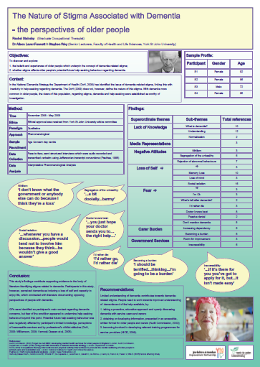
Stephen Wey and I partnered with
students to explore the nature of stigma associated with dementia. Qualitative projects using in-depth semi-structured interviews and focus groups which were audio-taped and transcribed verbatim. Participants recruited through Age Concern Day Centres.
Led to outputs for two level 3 OT students including two posters at a peer-reviewed International Dementia conference.
The Yorkshire and Humber Improvement Partnership supported with funding for the students to attend.
Stainsby R, Laver-Fawcett AJ, Wey S (September 2009) Poster presentation. The nature of Stigma Associated with Dementia: the perspectives of older people. Dementia Services Development Centre (DSDC) 3rd International Conference, York, UK

Slide 32
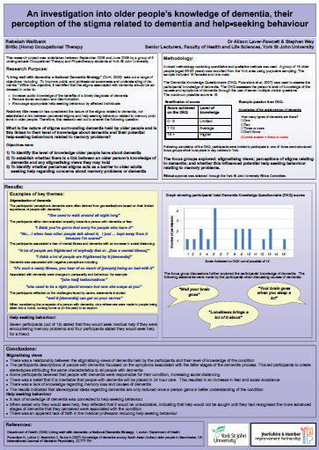
Laver-Fawcett AJ, Wey S (September 2009) Poster presentation. An investigation into older people’s knowledge of dementia, their perception of stigma related to dementia and help-seeking behaviour. Dementia Services Development Centre (DSDC) 3rd International Conference, York, UK
This project also led to an invited presentation:
Laver-Fawcett AJ, Stainsby R, Wallbank R (July 2009) Invited workshop. Reducing Stigma. Department of Health and Yorkshire and Humber Improvement Partnership Sub Regional Launch of the National Dementia Strategy ‘Key Priorities for Yorkshire and Humber’, in York

Slide 33

Involving Service users and Students in research
Partnership with York People first
A chance for people with Learning Disability (LD) to have their voices heard
Development of research skills for people with LD and students
Opportunity for students to develop relationships with & learn from people with learning disabilities
Cotterill D, Wolverson C, Bell A, Boothe M, Thompson R, Norat S, Oliver R, Pennell O, Stephens L, and Bradshaw A (2015) Shopping Experiences of People with Learning Disabilities. Learning Disability Practice (18) No p 16-21.

Slide 34
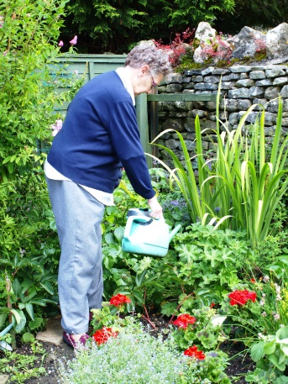
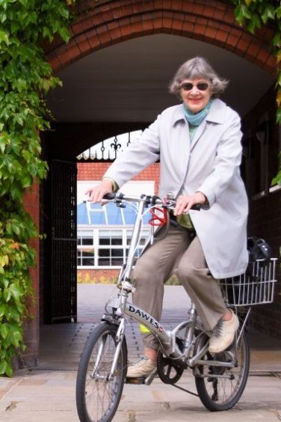
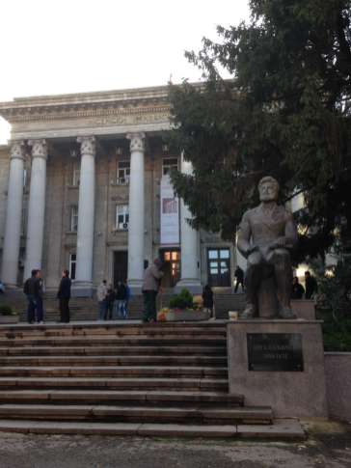
Face Validity and Clinical Utility of the Activity Card Sort -United Kingdom a Student as Co-Researcher project
Presented at the European Network of Occupational Therapists in Higher Education (ENOTHE)
Ruse, Bulgaria, October 2015
Notes:
research to evaluate the clinical utility and face validity of the United Kingdom version of the Activity Card Sort which I will refer to as the ACS-UK.
Eight occupational therapy students were collaborative researchers in a dissertation project which contributed to the development of the Activity Card Sort – United Kingdom
ENOTHE meeting
Friday 23rd October 2015
Oral Presentations 30 minutes (5 minutes to prepare, 20 minutes presentation and 5 minutes for questions and answers).

Slide 35
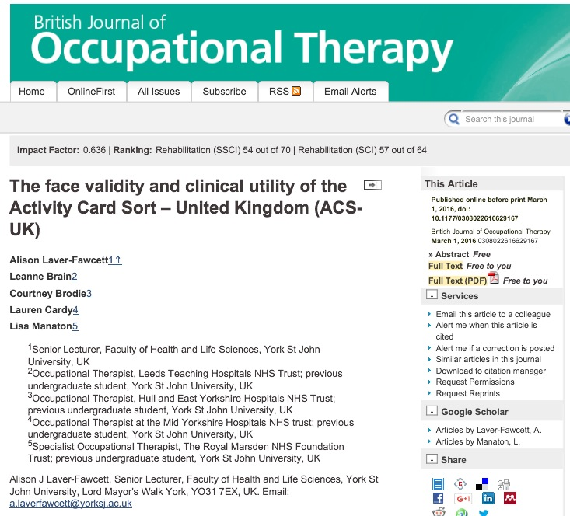

Slide 36


Structured Observational Test of Function (SOTOF)
SOTOF was the out put from my PhD in 1995
Recent SCoRe project outputs shared with
Masters OT students at University of Leuven, Belgium
2nd March 2016, Erasmus teaching exchange
Work improving the dynamic aspect of the SOTOF, which will be included in a 2nd edition of SOTOF, has been undertaken as a SCoRe project by level 3 OT student, Eden Marrison.

Slide 37
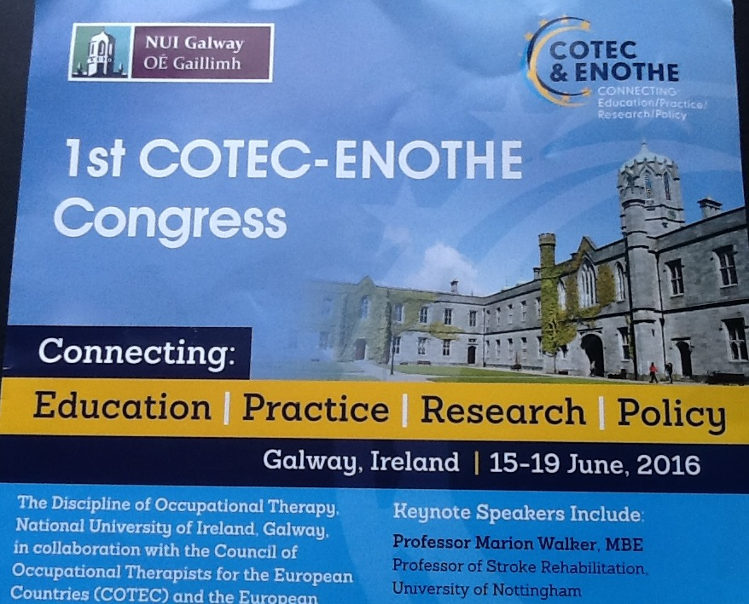

6 staff and several students presented at
the Council for Occupational Therapists in European Countries (COTEC) and European Network of Occupational Therapists in Higher Education (ENOTHE) joint conference in Galway in June 2016

Slide 38
COTEC / ENOTHE conference June 2016
'Interventions offered by occupational therapists in secure environments in the United Kingdom and Ireland?' (poster presentation) Rosie Davis, Lisa MacDonald, Jo Scull, Rebecca Washington, and Jane Cronin-Davis
'An exploration of the university experiences’ of occupational therapy and physiotherapy students with a disability on a professional health programme' (poster presentation) Elise Blackburn, Annabelle Downes, Jay Sherwood and Jane Cronin-Davis

Slide 39
Students and staff disseminating research together
Example Outputs with students have included presentations at national and international conferences and publication in a peer reviewed professional journal with an impact factor
Students are highly motivated by the publication of their research. They raise their attainment when they know that their work is not just for assessment by one or two university tutors but will be seen by a broader range of people, and that it links to authentic exposure (Spronken-Smith et al, 2013)

Slide 40
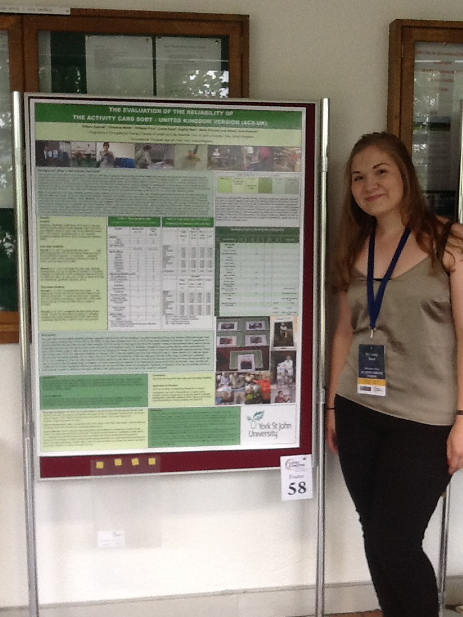
Dissemination

Slide 41
Future dissemination examples: COTEC / ENOTHE conference June 2016
“I was very excited and proud of our research group when our abstract was accepted for the conference. It felt all the hard work was worth it and it helped me to acknowledge that we had created a good quality piece of work which people would like to hear about.”
Contributing to the improvement of the dynamic aspect of the Structured Observational Test of Function (SOTOF) (oral presentation) Eden Marrison, Alison Laver-Fawcett
The Evaluation of the reliability of the Activity card Sort – United (poster presentation).Dritero Kastrati, Christine Muller, Philippa Price, Lorna Rand, Sophie Storr, Maria Pickard and Alison Laver-Fawcett
A Critical Review of the Evidence Base for Occupational Therapy Mental Health Practice for Children and Adolescents. (poster presentation) Sharon Cheek, Katie Grainge, Laura Kirk Alison Laver-Fawcett, Karen Wilson.

Slide 42
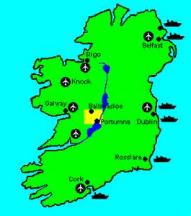
COTEC-ENOTHE Congress, June 15-19 2016
“I am very excited about having our abstract accepted for the COTEC/ENOTHE conference in June. It's made me feel very proud of my group and it makes all of that work (and stress!) feel worthwhile. I am looking forward to presenting and its made me more confident in my abilities as a qualified practitioner. I feel that it will help when applying for jobs because employers will recognise my ability to dedicate myself to a project and ability to produce a high-standard piece of work.”
“I feel really excited about being accepted to a conference. I feel really proud of achieving something like this before I have graduated and a great start for my career. Great opportunity for CPD as well…I also think it has boosted my confidence and actually doing the conference will boost it further and give me great experience. ”

Slide 43
Feedback from students: disseminating their work at a conference
“Our abstract being accepted to the COTEC/ENOTHE conference has been fantastic and exciting news! I feel that this is a great opportunity for us when applying for future posts and for me personally in my application for a PhD in OT”
“It does feel amazing to have our abstract accepted for such a great conference and to have the opportunity to present. It encourages me to continue looking at ways to contribute to the evidence base once I have started work as a practitioner. I think being able to talk about the conference when applying for posts will be a definite boost including all the other links into research this module has given me.”

Slide 44
Benefits of SCoRe projects
For Students…
Enhanced learning experience
‘Real world’ professionally relevant project
Transferable skills
Employability
Possibility for an output and dissemination beyond the assignment
Opportunity to genuinely ‘contribute to the evidence base’ is motivating
Consideration of a PhD
For Staff…
Genuine partnership and engagement with students is rewarding
Supervision and marking is more interesting and aligned to own research interests
Collecting primary data
Can build programmes of research
Working smarter
Opportunity for publications and dissemination

Slide 45
Students’ Perceptions of Benefits
Transferable skills: “I have thoroughly enjoyed completing this SCoRe project with my group and feel that I have gained a lot of valuable, transferrable skills which I will be able to utilise in practice”
Employability: “I feel it helped me get a job, I spoke about it in my interviews”
“I think it will be an asset when applying for jobs as it enables you to stand out and demonstrates a variety of skills such as being able to work as part of a team and being able to motivate and dedicate myself to a project”
Inspiring future researchers: “After having the opportunity to take part in research and develop my skills and confidence, I would love to have the opportunity within my career to take part in more research in the future.”
(quotes from level 3 OT students)

Slide 46
o discuss in small groups
How might you encourage students to participate in co-production of research?
How do we facilitate and motivate students to engage with research?
What will the opportunities and challenges be?
Does this need a culture shift?

Slide 47
Healey, Flint and Harrington, 2014

Slide 48

References
Healey M, Flint A, Harrington K (2014) Engaging through partnership: students as partners in learning and teaching in higher education. Higher Education Academy.
Higher Education Academy (HEA; 2015a) Framework for student engagement through partnership. HEA. Available from: https://www.heacademy.ac.uk/enhancement/frameworks/framework-student-engagement-through-partnership [accessed 13 March 2016]
Higher Education Academy (HEA; 2015b) Framework series: student engagement through partnership. HEA. Available from: https://www.heacademy.ac.uk/sites/default/files/downloads/student-enagagement-through-partnership.pdf [accessed 13 March 2016]
Spronken-Smith, R. A., et al. (2013). Completing the research cycle: A framework for promoting dissemination of undergraduate research and inquiry Teaching & Learning Inquiry. The ISSOTL Journal 1 (2) 105- 118.

Slide 49
Some useful texts
Brew, Angela. (2006) Research and Teaching: Beyond the Divide. London
Healey M, Jenkins A (2009) Developing Undergraduate Research and Inquiry. York: Available from: https://www.heacademy.ac.uk/sites/default/files/developingundergraduate_final.pdf [accessed 13 March 2016]
Griffiths, R (2004) "Knowledge production and the research-teaching nexus: the case of the built environment disciplines", Studies in Higher Education 29 (6): 709-26.
Jenkins A, Healey M (2005) "Institutional strategies to link teaching and research" Higher Education Academy.

Slide 50

If you would like a copy of this Power point, or further details about the ‘Contributing to the Evidence Base’ module or assignment and teaching materials please email me:
a.laverfawcett@yorksj.ac.uk
York St John University
Lord Mayor’s Walk
York
YO31 7EX
01904-876419
Notes:
These are my contact details

