Slide 1
Test development, standardisation, reliability and validity
Alison J Laver-Fawcett
a.Laverfawcett@yorksj.ac.uk
CRP, March 2017

Slide 2
A standardised assessment is…
‘A published measurement tool, designed for a specific purpose in a given population, with detailed instructions provided as to when and how it is to be administered and scored, interpretation of the scores, and results of investigations of reliability and validity’
(Cole et al, 1995, p. 22)

Slide 3
Key components of Test critique
Purpose
Client group
Level(s) of function addressed
Reliability: test-retest, inter-rater, internal consistency, parallel form, sensitivity, specificity, responsiveness to change
Floor and ceiling effects

Slide 4
Key components of Test critique
Validity: content, construct, predictive, concurrent, criterion-related, discriminative
Level of measurement (N.O.I.R.)
Normative data (if relevant)
Face validity
Clinical utility

Slide 5
Worksheets in Handout
Worksheet 5: Basic checklist for reflecting on the adequacy of standardisation
Worksheet 12: detailed Test Critique proforma – to use
Laver-Fawcett, 2007 provides a completed example of a test critique on pages 354-359

Slide 6
How can you tell if an assessment is standardised?
Is there a test manual?
Does the test manual describe:
  the test development process?
  the purpose of the test
  client group for whom the test has been developed?

Slide 7
How can you tell if an assessment is standardised?
  Does the test manual describe:
  details of psychometric studies undertaken to establish reliability and validity?
  the materials needed for test administration or are these included as part of the test package?
  the environment that should be used for testing?

Slide 8
How can you tell if an assessment is standardised?
Is there a protocol for test administration that provides all the instructions required to administer the test?
Is there guidance on how to score each test item?
Is there a scoring form for recording scores?
Is there guidance for interpreting scores?

Slide 9
Purposes of assessment
Selection of an appropriate outcome measure must be made in response to identification of a specific measurement purpose. Use of several outcome measures may be needed in order to provide comprehensive information about the outcomes for each individual service user (COT 2012)

Slide 10
Revision: Categories of Purpose
Descriptive
Discriminative
Predictive
Evaluative
See Laver-Fawcett, 2007, Chapter 3
Outcome measures are a type of evaluative assessment

Slide 11
Revision: Four Levels of Measuring Data
(N. O. I. R.)
York St John University | www.yorksj.ac.uk

Slide 12
Level of measurement - Why do we need to know?
Many assessments involve scoring systems that include summing or manipulating scores to obtain a total score or subtest scores.
Therapists need to be sure that they are using numbering on a scale in a valid and meaningful way.
The different ways in which numbers are applied for measurement has been categorized.
These categories are perceived to fall in a hierarchy of four levels of measurement.
(Laver-Fawcett 2007 p138)

Slide 13
Level of measurement - Why do we need to know?
It is critically important that you understand the differences between four levels of measurement.
You need to be able to look at the scoring system of a measure and identify which level of measurement it is using.
Once you know the level of measurement, you need to understand what you can and cannot do with numerical scores obtained on the test.
(Laver-Fawcett, 2007, p138)

Slide 14
Revision: Norm-referenced test:
A test that is used to evaluate performance against the scores of a peer group whose performance has been described using a normative sample.
Norms: Norms are sets of scores from clearly defined samples of a population (Kline, 1990)
A wider definition refers to norms as “a standard, a model, or pattern for a specific group; an expected type of performance or behaviour for a particular reference group of persons” (American Occupational Therapy Association, as cited in Hopkins and Smith, 1993, p.914)
Can you think of examples of norm-referenced tests you observed being used on placement?

Slide 15
A normal curve showing standard deviations above and below the mean
For many tests of dysfunction the cut of point for identifying a
deficit falls 1 standard deviation below the mean.

Slide 16
Norm-referenced test
If it is a norm-referenced test, is the normative sample well described?
Are there norm-tables from which you can compare a client’s score with the distribution of scores obtained by the normative group?
If you are using a normative assessment – look carefully at the sample used and consider generalisability

Slide 17
Validity & Reliability
In order for any measurement to be clinically useful it should meet two essential requirements:
First it should measure what it intends or is supposed to measure (validity)
Second, it should make this measurement with a minimum of error (reliability)
(Pysent, 2004)

Slide 18
A target analogy for reliability and validity
The ‘Bull’s eye’ represents the true outcome to be measured and each arrow represents a single application of the outcome instrument (Pysent, 2004)

Slide 19
Some questions to reflect on:
Am I really assessing and measuring what I want and need to assess/measure?
How can I be reassured that a standardised test is valid?
What types of validity should I be concerned about? why? when?

Slide 20

Recap: So what is Validity?
Validity: is the ‘extent to which a measurement method measures what it is intended to’
(McDowell and Newell, 1987, p. 330)
Validity relates to the appropriateness and justifiability of the things supposed about the person’s scores on a test and the rationale therapists have for making inferences from such scores to wider areas of functioning
(Bartram, 1990)
Does what it says on the tin

Slide 21
Why is validity important?
The things OTs measure are not always directly observable
Test items are developed to elicit self-reported descriptions (e.g. of feelings)
People are provided with test items that link to hypothesised behaviours

Slide 22
Validity
Three types of validation studies, known as:
content validation
construct validation
criterion related validation
are traditionally performed during test development
(Crocker and Algina, 1986)

Slide 23
Content validity
The degree to which an assessment measures what it is supposed to measure judged on the appropriateness of its content as judged by ‘the comprehensiveness of an assessment and its inclusion of items that fully represent the attribute being measured’
(Law, 1997, p. 431)
content analysis of literature
and / or
expert panel review
Have the domains to be measured been weighted to reflect their relative importance to the overall content area?

Slide 24
Construct validity
The extent to which an assessment can be said to measure a theoretical construct(s) and ‘the ability of an assessment to perform as hypothesized’
(Law, 1997, p. 431)
Construct: “a product of scientific imagination, an idea developed to permit categorization and description of some directly observable behaviour”
(Crocker and Algina, 1986, p. 230)
Is there a clear statement explaining any underlying theory or assumptions?
exploring the relationship between hypothesized variables, e.g. through factor analysis

Slide 25
Criterion-referenced tests
Is a test that examines performance against pre-defined criteria and produces raw scores that are intended to have a direct, interpretable meaning (Crocker and Algina, 1986)

Slide 26
Criterion-related validity
The effectiveness of a test in predicting an individual’s performance in specific activities
this is measured by comparing performance on the test with a criterion
which is a direct and independent measure of what the assessment is designed to predict.

Slide 27
Validity
These areas of validation can be further sub-divided into specific validity study areas exploring aspects such as
predictive validity
discriminative validity
factorial validity
concurrent

Slide 28
Discriminative validity
Relates to whether a test provides a valid measure to distinguish between individuals or groups
E.g. for diagnosis or eligibility for a service or funding
Is there evidence that different groups of people perform differently on the test?
Does the test actually discriminate as expected?
(Laver-Fawcett, 2012)

Slide 29
Predictive validity
‘The accuracy with which a measurement predicts some future event, such as mortality’
(McDowell and Newell, 1987, p. 329).
Is the test used to make predictions about future ability, functioning in a different environment ?
E.g. Risk assessments
Have they done a longitudinal study and followed up to see if predictions were accurate?

Slide 30
Concurrent validity
Is ‘the extent to which the test results agree with other measures of the same or similar traits and behaviours’ (Asher, 1996, p. xxx).
Note: also sometimes referred to as congruent or convergent validity.
What other measures have been selected as concurrent measures?
What is the correlation between items of the test and these other measures?

Slide 31
Face validity
whether a test seems to measure what it is intended to measure (Asher, 1996)
in particular face validity concerns the acceptability of a test to the test-taker (Anastasi, 1988).
Test is acceptable to:
the test-taker (service user)
Clinicians and managers who decide on its use
people who look at the results
Usually evaluated through a survey method, e.g. interviews or questionnaires

Slide 32
So what is Reliability?
Reliability refers to the stability of test scores overtime and across different examiners
(de Clive-Lowe, 1996)
Repeatability: how consistently an assessment can repeat results over time.

Slide 33
Why is reliability important to occupational therapists?
The implications of false positive and false negative results
The implications of not detecting clinically important change
How much error is acceptable?
Error owing to practice effects
Error owing to rater (therapist) variation in test administration and scoring

Slide 34
Reliability
There are several types of reliability. The relevance of a particular reliability study depends on the purpose of the assessment.
Inter-rater and test-retest reliability studies are quantitative, correlation design
Non-experimental, with data collected on two or more variables and the relationship explored
(Grady and Wallston as cited in Sim and Wright, 2000 p70)
Seek to establish the relationship between different test administrators or the time between assessments.

Slide 35
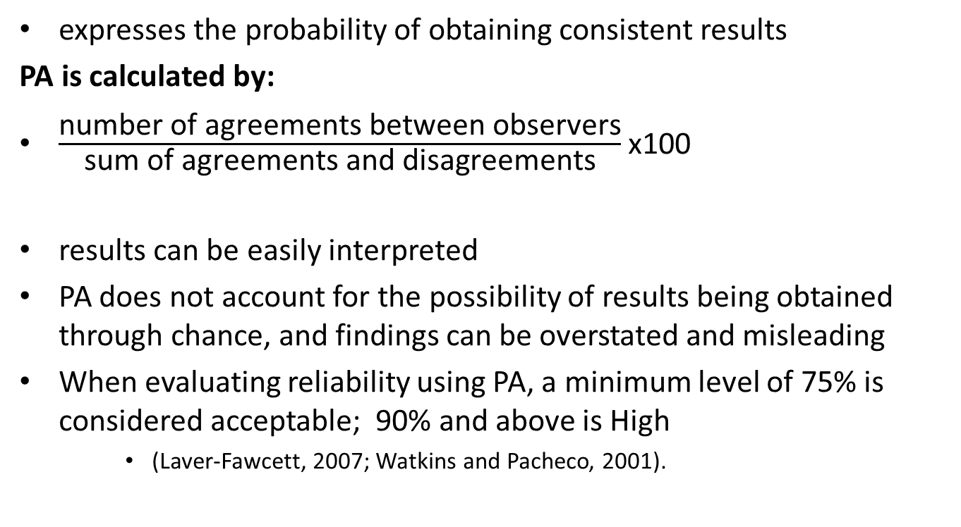
Percentage agreement
expresses the probability of obtaining consistent results
PA is calculated by:
$\frac{\text{number} \text{of} \text{agreements} \text{between} \text{observers}}{\text{sum} \text{of} \text{agreements} \text{and} \text{disagreements}}$x100
results can be easily interpreted
PA does not account for the possibility of results being obtained through chance, and findings can be overstated and misleading
When evaluating reliability using PA, a minimum level of 75% is considered acceptable; 90% and above is High
    (Laver-Fawcett, 2007; Watkins and Pacheco, 2001).

Slide 36
Statistics related to reliability
Intra-class correlation coefficients (ICCs)
Correlation coefficients: ‘Fox (1969, as cited in Asher, 1996) categorised correlations into four levels:
correlations from 0 to + or - 0.50 are low
correlations from + or - 0.50 to 0.70 are moderate
correlations from + or - 0.70 to 0.80 are high
correlations greater than + or - 0.86 are very high’
(Laver-Fawcett, 2007, p. 205)

Slide 37
Test re-test reliability
Test-retest reliability: the correlation of scores obtained by the same person on two administrations of the same test and is the consistency of the assessment or test score over time (Anastasi, 1988).

Slide 38
Appraising a
Test-retest reliability study
The same rater (therapist) should administer the test on both occasions.
Samples sizes: how many raters? How many participants?
What is the length of time between tests with the 1st and 2nd rater?
Would change be likely to occur during that time period?
Is there likely to be a learning or practice effect on the assessment? Will they do better on the test 2nd time?

Slide 39
Test-retest reliability
What is an acceptable result?
an acceptable correlation coefficient for test-retest reliability is considered to be 0.70 or above
  (Benson and Clark, 1982; Opacich, 1991).

Slide 40
Intra-rater reliability
The consistency of the judgements made by the same test administrator (rater) over time.
Studies of intra-rater reliability are less common. The methodology is very similar to a test-re-test reliability study so the factors to consider are the same.

Slide 41
Inter-rater reliability
The level of agreement between or among different therapists (raters) administering the test.

Slide 42
Appraising an Inter-rater reliability study
How many raters (therapists / test administrators) are used in the study?
What training have they had on how to administer and score the assessment?
How have they paired up the raters in the sample?
Is there a difference in the level of clinical experience of the raters (therapists)?

Slide 43
Appraising an
Inter-rater reliability study
How many participants (patients / subjects)
Have they fully administered the test and scored it?
Have the just scored it from observation, e.g. a video?
What is the length of time between tests with the 1st and 2nd rater?
Would change be likely to occur during that time period?

Slide 44
Appraising an
Inter-rater reliability study
Is there likely to be a learning or practice effect on the assessment? Will they do better on the test 2nd time?
Are the participants likely to experience fatigue? What rest period if given between the first and 2nd test?
Are they likely to be less motivated / bored doing the test a 2nd time so soon?

Slide 45
Inter-rater reliability
ICC 0.90 or above is considered an acceptable level
  (Benson & Clark, 1982; Opacich, 1991).

Slide 46
Parallel form reliability
The correlation between scores obtained for the same person on two (or more) forms of a test (also known as equivalent form or alternate form reliability).
E.g the Middlesex Elderly Assessment of Mental State (MEAMS) has versions A and B
Often developed when there could be a learning / practice effect that could impact accurate measurement of outcomes.

Slide 47
Reliability: What is acceptable?
Parallel Form reliability: coefficients ranging in the 0.80s and 0.90s are acceptable for equivalent (alternate / parallel) form reliability (Crocker and Algina, 1986).

Slide 48

Sensitivity
‘The ability of a measurement or screening test to identify those who have a condition
calculated as a percentage of all cases with the condition who were judged by the test to have the condition: the ‘true positive’ rate’ (McDowell and Newell, 1987, p. 330)
Particularly important for discriminative / diagnostic tests

Slide 49

Specificity
“The ability of a measurement to correctly identify those who do not have the condition in question”
calculated as a percentage of all cases with the condition who were judged by the test to have the condition: the ‘true negative’ rate
(McDowell and Newell, 1987, p. 330)

Slide 50
Responsiveness
Responsiveness to change refers to the measure of efficiency with which a test detects clinical change
(Wright, Cross and Lamb, 1998)
It is very important to identify if an outcome measure has established responsiveness to the degree of change anticipated to be achieved through your rehabilitation intervention.

Slide 51
Internal consistency
‘The degree to which test items all measure the same behaviour or construct’ (Laver-Fawcett, 2007, p.422).
Internal consistency studies explore if test items are measuring the same construct or trait and whether test items vary in difficulty
Cronbach’s alpha often used to determine internal consistency
  Correlations less than +/- 0.85 are poor
  Correlations from +/- 0.85 to 0.91 are good
  Correlations greater than +/- 0.91 are excellent

Slide 52
Reliability Worksheets

Slide 53
Clinical Utility
Ease of use
Cost
Portability
Interpretability of results
Time taken to complete administration and scoring
Equipment/ items needed to complete it
Level of skill required to complete it (do you need additional training)
The amount of participation required by the client
Acceptability to the practice setting and the client group (language and culture)

Slide 54
Clinical utility Worksheet

Slide 55
Critiquing potential measures
Look for critiques by other authors (e.g. Asher, 2007)
Corr and Siddons (2005) provide an overview in their BJOT article
Section on test critique and a test critique worksheet in my text book

Slide 56
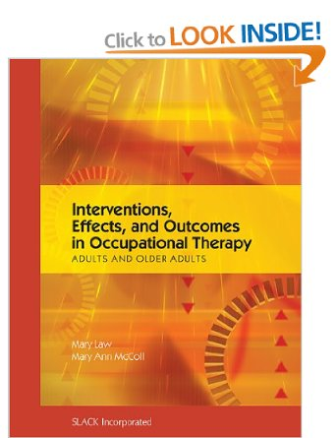
Recommended reading
Law, M., McColl, M.A. (2010) Interventions, Effects and Outcomes in Occupational Therapy: Adults and Older Adults. Thorofare, NJ: Slack

Slide 57

Key resource:
Asher IE (2007)
Occupational Therapy
Assessment Tools:
An Annotated Index
(3rd ed)
Bethesda:
AOTA Press

Slide 58
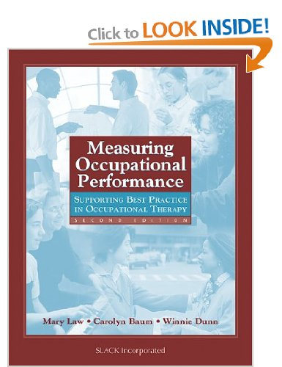
Where to look
Some text books include test critiques of measures, for example:
Law, Baum and Dunn (2005) Measuring occupational performance: supporting best practice in occupational therapy (2nd ed) (615.8515 LAW)
Literature search:
Data bases to access journal articles describing assessments and outcome measures

Slide 59
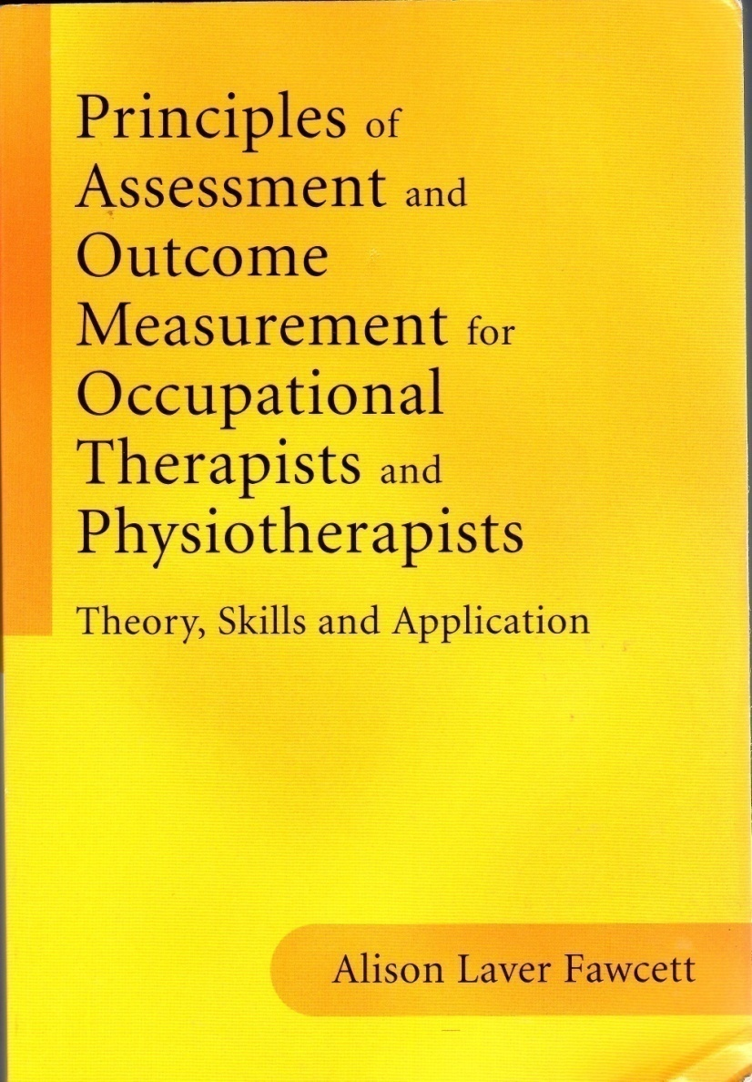
Follow-up reading:
Key reference for this session
Chapter 5: Standardisation and Test development
Chapter 6: Validity and Clinical Utility
Chapter 7: Reliability

Slide 60
References
Anastasi, A, (1988) Psychological Testing, 6th ed. New York: Macmillan
Bartram, D. (1990) Reliability and Validity. In: Beech JR, Harding L (eds) Testing People: A Practical Guide to Psychometrics. Windsor: NFER-Nelson, p 57-86
Baum, C. M., & Edwards, D. F. (2008). Activity Card Sort (ACS): Test manual (2nd Ed). Bethesda, MD: AOTA Press.
Benson, J., Clark, F. (1982) A guide for instrument development and validation. American Journal of Occupational Therapy, 36 (12) 789-800
Crocker, L., Algina, J. (1986) Introduction to classical and modern test theory. Fort Worth: Holt, Rinehart and Winston.
de Clive-Lowe S (1996) Outcome measurement, cost-effectiveness and clinical-audit: the importance of standardised assessment to occupational therapists in meeting these new demands. British Journal of Occupational Therapy, 59 (8) 357-362
Hopkins, H. L., Smith, H. D. (1993) Appendix G: Hierarchy of competencies relating to the use of standardized instruments and evaluation techniques by occupational therapists produced by the American Occupational Therapy Association (p. 913 - 915) In H L Hopkins and H D Smith (eds) Willard and Spackman’s Occupational Therapy (8th ed). Philadelphia: J B Lippincott company

Slide 61
References
Hunter, J. (1997) Outcome, indices and measurements. In CJ Goodwill, MA Chamberlain, C Evans (eds) Rehabilitation of the Physically Disabled Adult. Cheltenham: Stanley Thornes.
Kline, P. (1990) How Tests are Constructed and Selecting the Best Test In J R Beech & L Harding Testing People. Windsor: NFER-NELSON.
Laver, A.J., Powell, G.E. (1995) The Structured Observational test of Function (SOTOF). Windsor: NFER-Nelson
Laver-Fawcett, A. (2012) Activity Card Sort – Letter to the Editor. British Journal of Occupational Therapy, 75 (10) 482.
Laver-Fawcett, A.J., Mallinson, S. (2013) The Development of the Activity Card Sort – United Kingdom version (ACS-UK). OTJR: Occupation, Participation, and Health , 33 (3), 134-145. DOI: 10.3928/15394492-20130614-02

Slide 62
References
Laver-Fawcett A (2012) Assessment, Evaluation and Outcome Measurement. In: E Cara and A MacRae. Psychosocial Occupational Therapy: An evolving practice (3rd ed). New York: Delmar Cengage Learning
Laver-Fawcett, A. J. (2007) Principles of Assessment and Outcome Measurement for Occupational Therapists and Physiotherapists: Theory, Skills and Application. London: John Wiley and Sons Ltd.
Law, M. (1993) Evaluating activities of daily living: directions for the future. American Journal of Occupational Therapy, 47, 233-237
Law, M., Baum, C. (2001) Measurement in Occupational Therapy. In M. Law, C. Baum, W. Dunn (eds) Measuring Occupational Performance: Supporting Best Practice in Occupational Therapy. Thorofare: Slack
McDowell, I., Newell, C. (1987) Measuring Health: A Guide to rating Scales and Questionnaires. Oxford: Oxford University Press

Slide 63
References
Opacich, K. J. (1991) Assessment and informed decision making. In C. Christiansen, C. Baum( eds) Occupational Therapy – overcoming human performance deficits. Slack, New Jersey, p 355-372
Polgar, J.M. (1998) Critiquing Assessments. In M.E. Neistadt, E.B. Crepeau (eds) Willard & Spackman’s Occupational Therapy 9th edition. Philadelphia: Lippincott. p 169 - 183.
Stark, S., Hollingsworth, H.H., Morgan, K.A., Gray, D.B. (2007) Development of a measure of receptivity of the physical environment. Disability and Rehabilitation, 29 (2) 123-137
Unsworth, C. (2005) Measuring Outcomes using the Australian Therapy Outcome Measures for Occupational Therapy (AusTOMs - OT): Data Description and Tool Sensitivity . British Journal of Occupational Therapy, 68(8), 354-366
World Health Organisation (WHO; 2002) Towards a Common Language for Functioning, Disability and Health ICF. [online].Geneva: WHO. Available from: http://www.who.int/classifications/icf/en/ [Accessed3.5.13]
Wright, J., Cross, J., Lamb, S. (1998) Physiotherapy outcome measures for rehabilitation of elderly people: responsiveness to change of the Rivermead Mobility Index and Barthel Index. Physiotherapy, 84 (5) 216-221

